Slide 1
Present simple vs. present continuous
GRAMMAR
1/6
NEXT = EXAMPLES
Hi class. Today we are going to learn Grammar in Unit 1: Present simple vs. present continuous. Let’s get started

Slide 2
Present simple vs. present continuous
EXAMPLES
2/6
Pictures and texts will fade on when mentioned in the video
NEXT = MEANINGS
I have some questions for you. First, look at the picture on the left and tell me “What do we usually do every day?”. (pause a few seconds). Yes, we brush our teeth every day. Then, look at another picture and tell me “What are we doing now?” (pause a few seconds). That’s right. We are studying English now.

Slide 3
Present simple vs. present continuous
MEANINGS
3/6
Pictures and texts will fade on when mentioned in the video
NEXT = FORMS
So, can you find out the verb in each sentences? Yes. These are “brush” and “are studying”. What is the tense of the left sentences, class? (pause a few seconds). Yes, it is present simple to talk about things we do regularly. And how about the other? (pause a few seconds). It is present continuous tense. To talk about things which are happening at the moment of speaking.

Slide 4
Present simple vs. present continuous
FORMS
4/6
Pictures and texts will fade on when mentioned in the video
NEXT = PRACTICE
So now we will have a review on the forms of these tenses. Look at these examples and tell me the structure, negative form, and question form of each tense. (pause a few seconds). For the present simple, the structure is “Subject + verb”. Example for negative sentence is “He doesn’t brush his teeth every day. And the question sentence is “Do you brush your teeth every day?”. How about present continuous? Yes, the structure is “Subject + to be + verb + ing”. “He is not studying English now” is the negative sentence. And “Are you studying English now?” is question sentence.

Slide 5
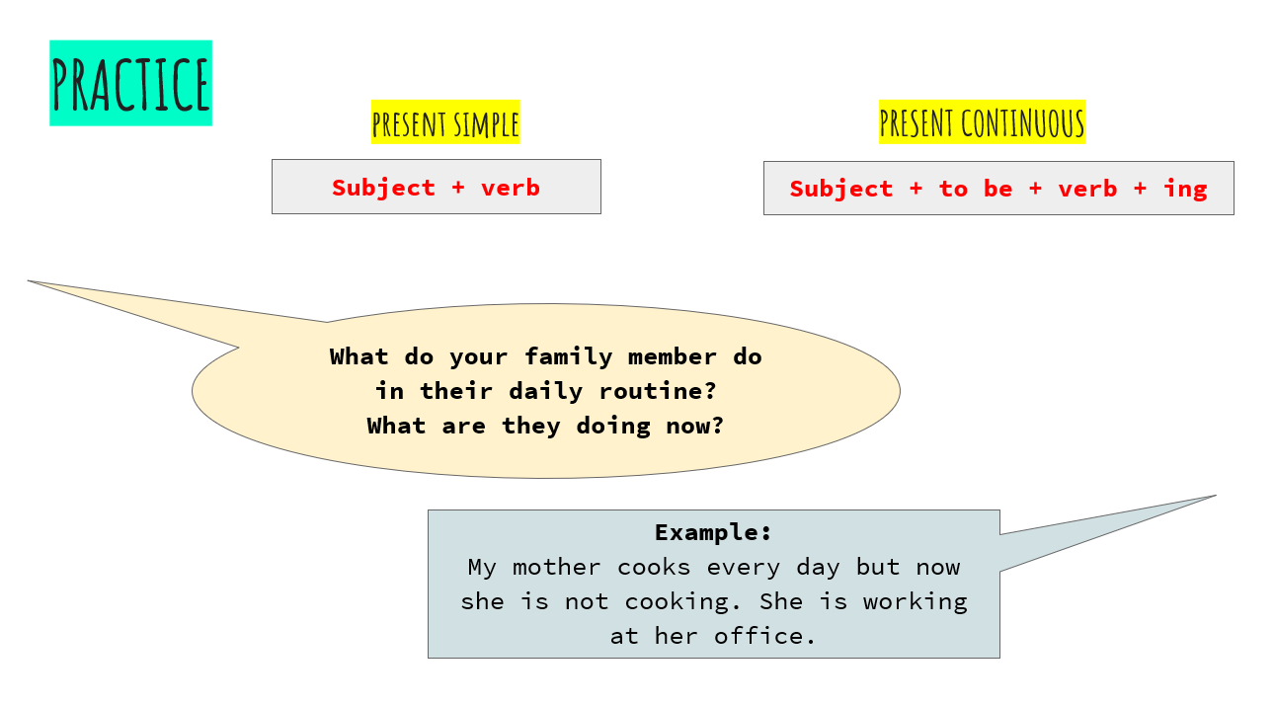
Present simple vs. present continuous
PRACTICE
5/6
Pictures and texts will fade on when mentioned in the video
NEXT = THANK YOU SLIDE
Ok, after we have a quick review about these two tenses, I want you have some practice with the questions here “What do your family member do in their daily routine? What are they doing now?” (Pause for a few seconds). Ok, I will give you example answer: “My mother cooks every day but now she is not cooking. She is working at her office.” Now it’s your turn to talk about your family member, such as your grandparent, your parents, your brother or sister.

Slide 6
Present simple vs. present continuous
THANK YOU
6/6
THE END
That’s all for today grammar lesson. See you in the next video.

