Slide 1

Teaching Vocabulary Unit 1
Introduction
1/6
Slide advances by user
NEXT = Word “Breadwinner”
Hello class, today, we will start with Unit 1. I’ll give you some useful vocabulary of this unit. Now, let’s start

Slide 2


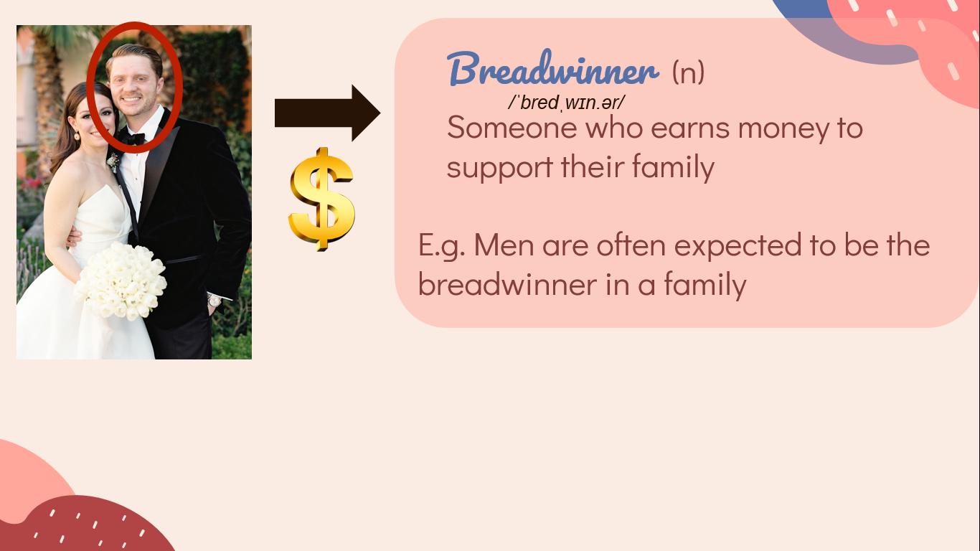
Teaching Vocabulary Unit 1
Word “Breadwinner”
2/6
Slide advances by user
NEXT = Word “Homemaker”
Look at the picture. Answer this question “When do people take this picture?”. It is on Wedding Day. So now, who is this man? That’s right.
He is a Groom or Husband. He usually earns money for family. So we call him “Breadwinner”. Repeat after me “breadwinner”. This is a noun.
Listen to the example: Men are often expected to be the breadwinner in a family.

Slide 3


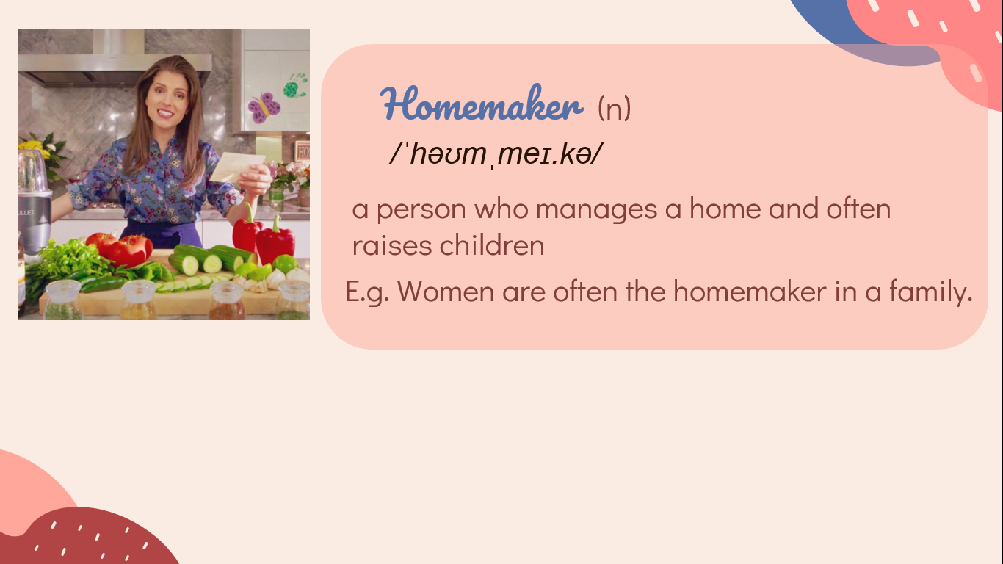
Teaching Vocabulary Unit 1
Word “Homemaker”
3/6
Slide advances by user
NEXT = Word “Groceries”
Look at the picture. Answer this question “Who is she?”. She is a Bride or Wife. Now, where is she? In the kitchen. She usually stays at home and takes care of members in family. So we call her “Homemaker”. Repeat after me “Homemaker”. This is a noun.
Listen to the example: Women are often the homemaker in a family.

Slide 4


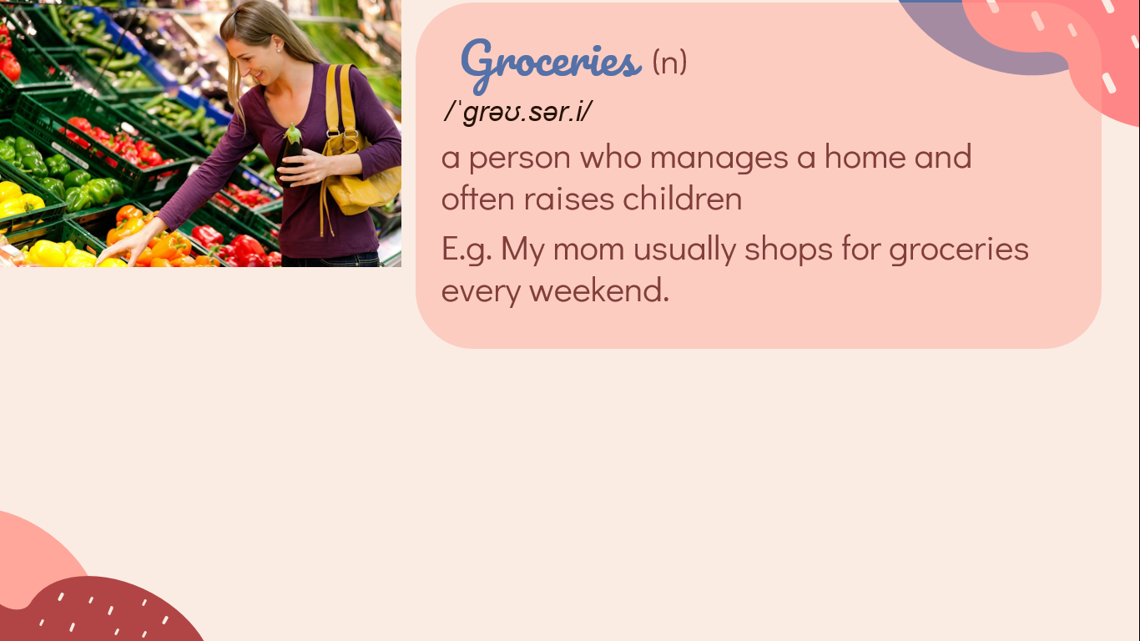
Teaching Vocabulary Unit 1
Word “Groceries”
4/6
Slide advances by user
NEXT = Word “Heavy lifting”
Move to the next word. Look at this woman. What is she doing?. Going shopping, right?
What is she buying? Vegetable. Or we can say “Groceries”. Repeat after me “Groceries”. This is a noun in plural form.
Listen to the example: My mom usually shops for groceries every weekend.

Slide 5
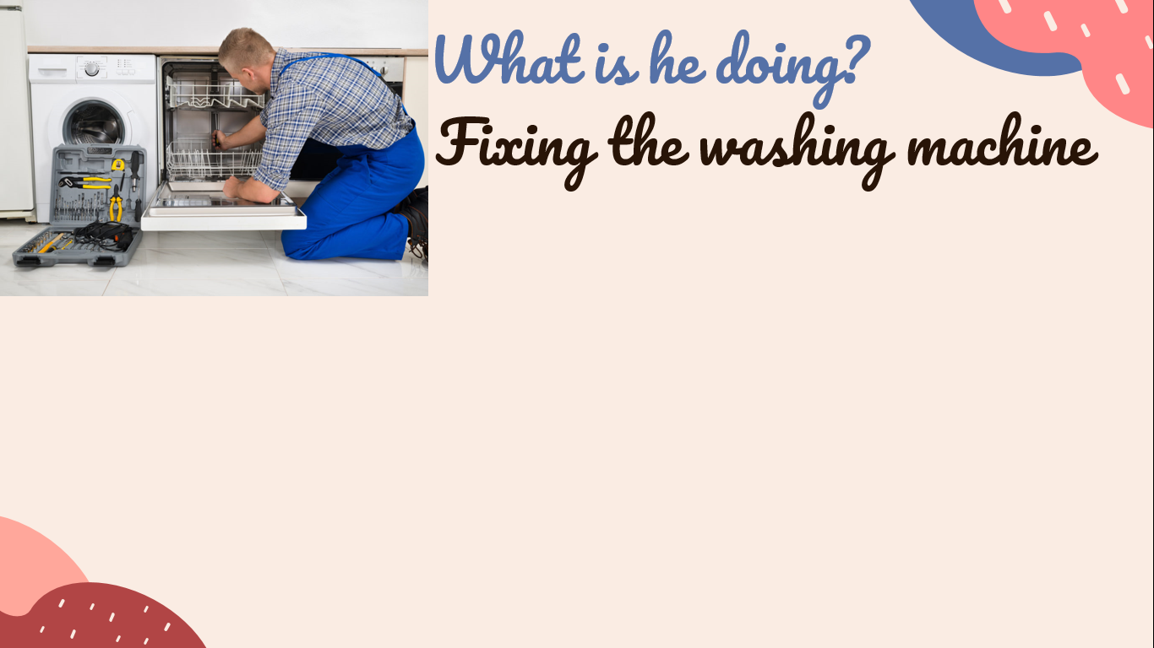
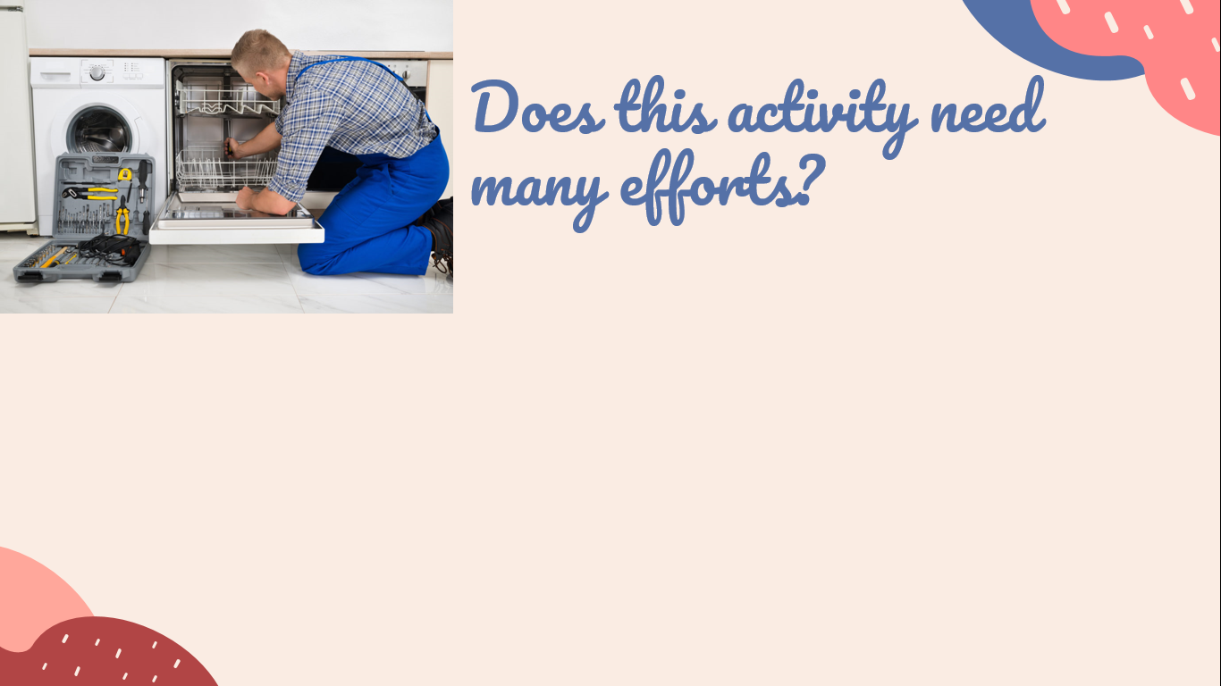
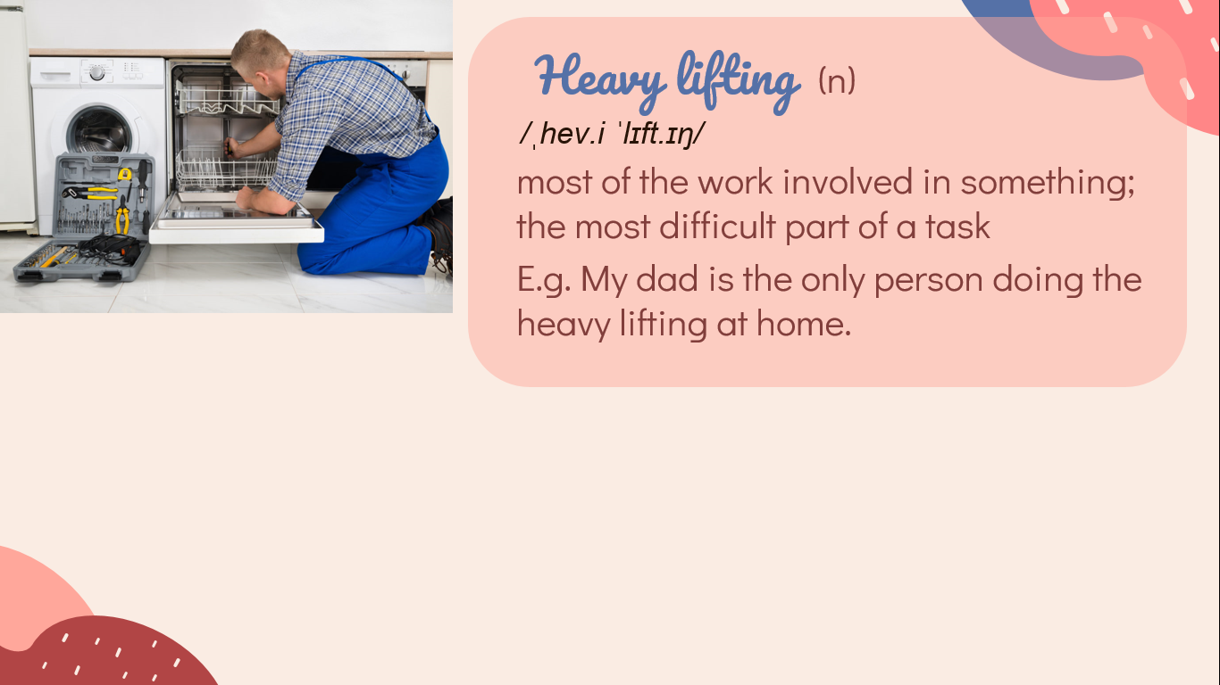
Teaching Vocabulary Unit 1
Word “Groceries”
5/6
Slide advances by user
NEXT = Thanks
The last word of today. What is he doing?. He is fixing the washing machine.
Does this activity need many efforts? Of course, Yes. So we can call this type of activity “Heavy lifting”. Repeat after me “Heavy lifting”. This is also a noun.
Listen to the example: My dad is the only person doing the heavy lifting at home.

Slide 6

Teaching Vocabulary Unit 1
Thanks
1/6
Slide advances by user
This is the end of our lesson today. Please remember to note these vocabulary and do the assignment in LMS. Goodbye!

