Slide 1
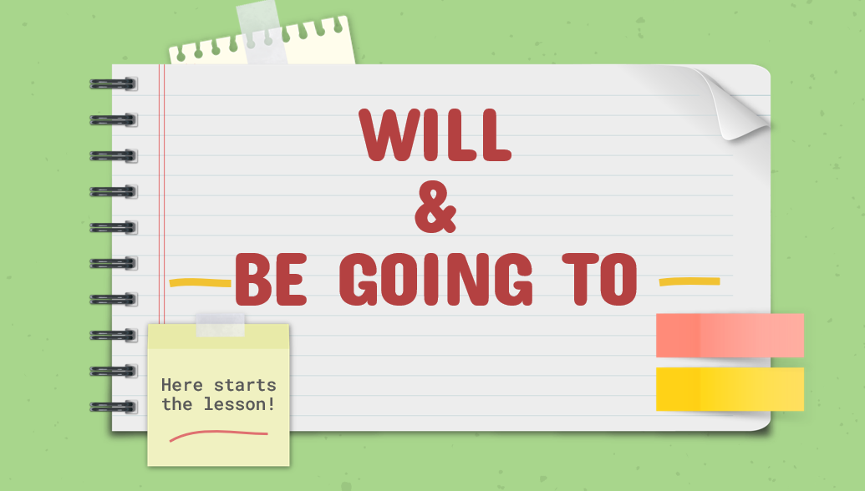
Project name: Unit 2 - Grammar | Screen title: Lead-in | Screen #: 1/6
 |  | Graphic info:
 |  | Navigation:
 |  | Slide advances by presenter
 |  | Reviewer comments:
Audio: Hello my students and welcome to our lesson today! Today we will study about will and be going to As you know, will and be going to talk about the future actions This lesson will help you to know what is the different between them?

Slide 2
Project name: Unit 2 - Grammar | Screen title: Structure - will | Screen #: 2/6
 |  | Graphic info:
 |  | Navigation:
 |  | Slide advances by presenter
 |  | Reviewer comments:
Audio: So now let’s review the structure of Will The first one is affirmative sentence: S + will + V-infinite. Negative sentence: S + will not / won’t + V-infinitive Question: Will + S + V-infinitive?

Slide 3
Project name: Unit 2 – Grammar | Screen title: Structure – be going to | Screen #: 3/6
 |  | Graphic info:
 |  | Navigation:
 |  | Slide advances by presenter
 |  | Reviewer comments:
Audio: So now let’s review the structure of Be going to The first one is affirmative sentence: S + am/is/are +going to + V infinitive Negative sentence: S + am/is/are + going to + V -infinitive Question: (?) Am/is/are + S + going to + V –infinitive?

Slide 4
Project name: Unit 2 - Grammar | Screen title: Will and be going to | Screen #: 4/6
 |  | Graphic info:
 |  | Navigation:
 |  | Slide advances by presenter
 |  | Reviewer comments:
Audio: And now we will focus on the different between will and be going to About will Express future actions at the moment of speaking => I will have salad and the fish Express a prediction based on personal opinions or experiences (Predictions without evidence) => I think France will win the champion Express a future fact. => The sun will raise tomorrow

Slide 5
Project name: Unit 2 - Grammar | Screen title: Will and Be going to | Screen #: 4/6
 |  | Graphic info:
 |  | Navigation:
 |  | Slide advances by presenter
 |  | Reviewer comments:
Audio: About be going to Express future plans before the moment of speaking => I am going to visit my aunt next Friday Express a prediction based on present evidence (Prediction with evidence) => Look at those black clouds. It is going to rain. Express something that is about to happen => Get back! The bomb is going to explode

Slide 6
Project name: Unit 2 - Vocabulary | Screen title: The end | Screen #: 6/6
 |  | Graphic info:
 |  | Navigation:
 |  | Slide advances by presenter
 |  | Reviewer comments:
Audio: Thank you for listening!

