Slide 1
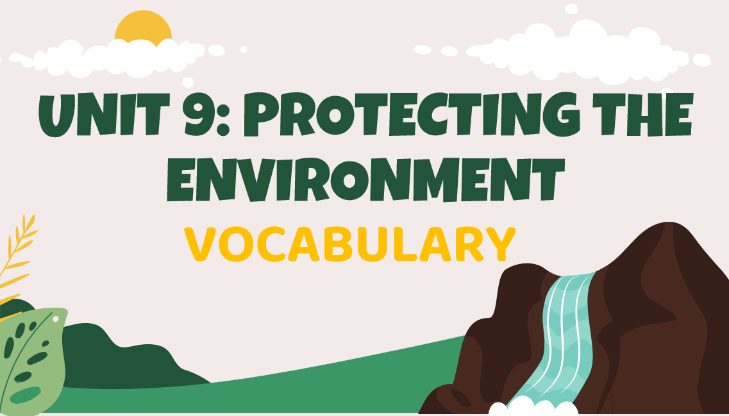
U9 [VOCABULARY]
Introduction
1/9
Slide advances by user
Navigation info:
NEXT=Lead-in to the first word (2/9)
Hello class, welcome back to the Vocabulary Unit 9: Protecting the environment. Today we will learn some new words related to the environment. Okay, let’s get started!

Slide 2
U9 [VOCABULARY]
Lead-in to the first word
2/9
Slide advances by user
Navigation info:
NEXT=Lead-in to the first word (3/9)
Now first one, can you name some animals and plants that live in the jungle?
Okay, you can see in the picture, there are elephants, tigers, monkeys, parrots, snakes appearing in the picture. And about the plants, you can see there are some kinds of flowers or mushrooms.

Slide 3
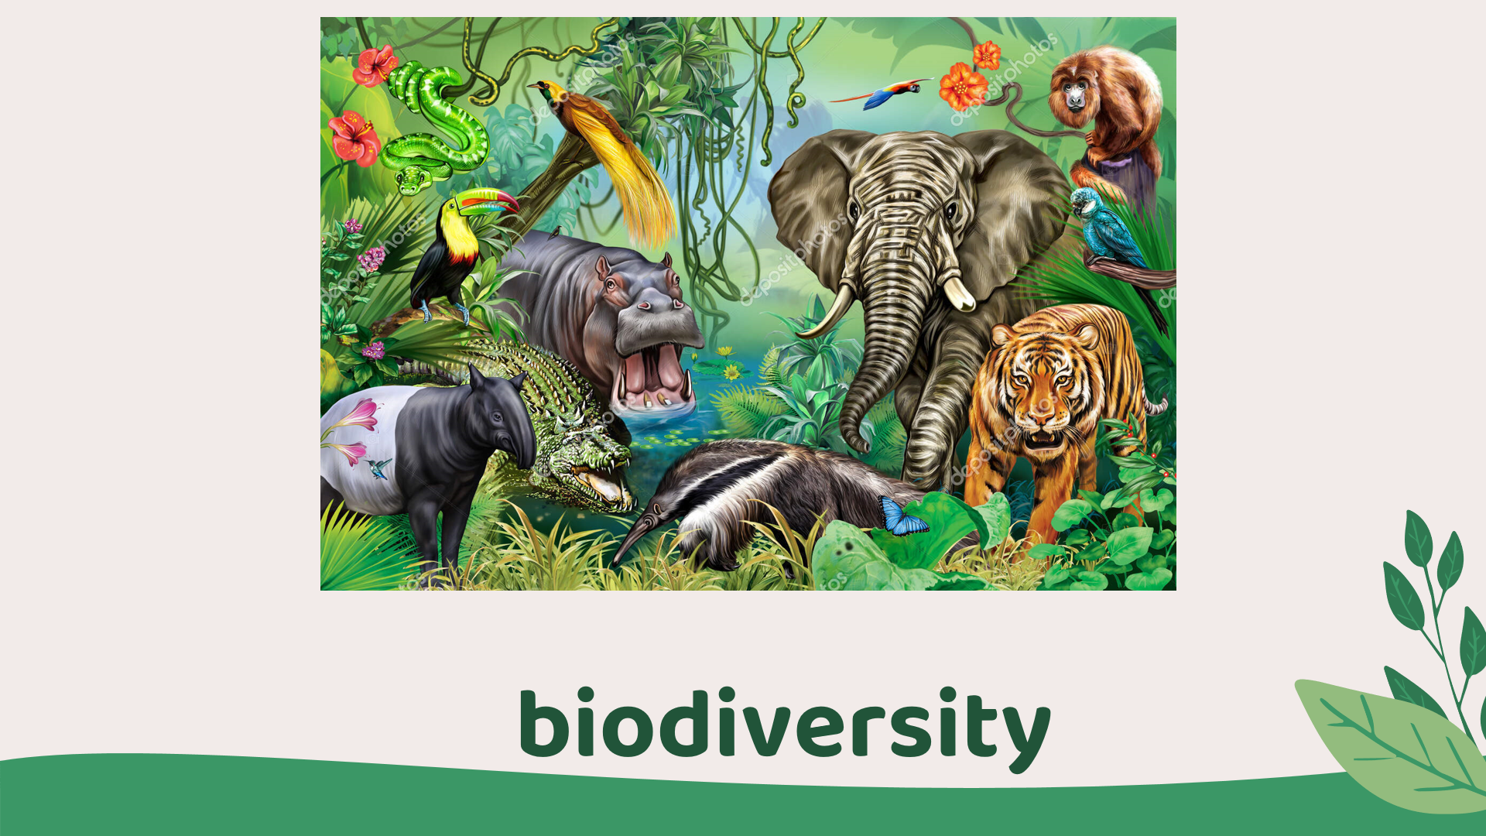
U9 [VOCABULARY]
Lead-in to the first word
3/9
Slide advances by user
Navigation info:
NEXT=First word (4/9)
Okay we can call all different kinds of animals and plants that live in the jungle is biodiversity.

Slide 4
U9 [VOCABULARY]
First word
4/9
Slide advances by user
Navigation info:
NEXT=Lead-in to the second word (5/9)
So biodiversity is a noun to indicate the variety of different kinds of animals and plants found in a particular area.
For example, Biodiversity is important because plants and animals depend on each other to survive.

Slide 5
U9 [VOCABULARY]
Lead-in to the second word
5/9
Slide advances by user
Navigation info:
NEXT=Lead-in to the second word (6/9)
Now we will go to the next word, look at the picture, can you tell where do the fish live?
Okay, the fish live in the water. So what about the cactus, where do cactus live?
Cactus live in the desert.
Okay you can call that…

Slide 6
U9 [VOCABULARY]
Lead-in to the second word
6/9
Slide advances by user
Navigation info:
NEXT=Second word (7/9)
The water and the desert are the places where fish and cactus live, or we can call these two places are habitats.

Slide 7
U9 [VOCABULARY]
Second word
7/9
Slide advances by user
Navigation info:
NEXT=Lead-in to the third word (8/9)
So, habitat is a noun to indicate the natural home of an animal or plant.
For example, the panda’s natural habitat is the bamboo forest.

Slide 8
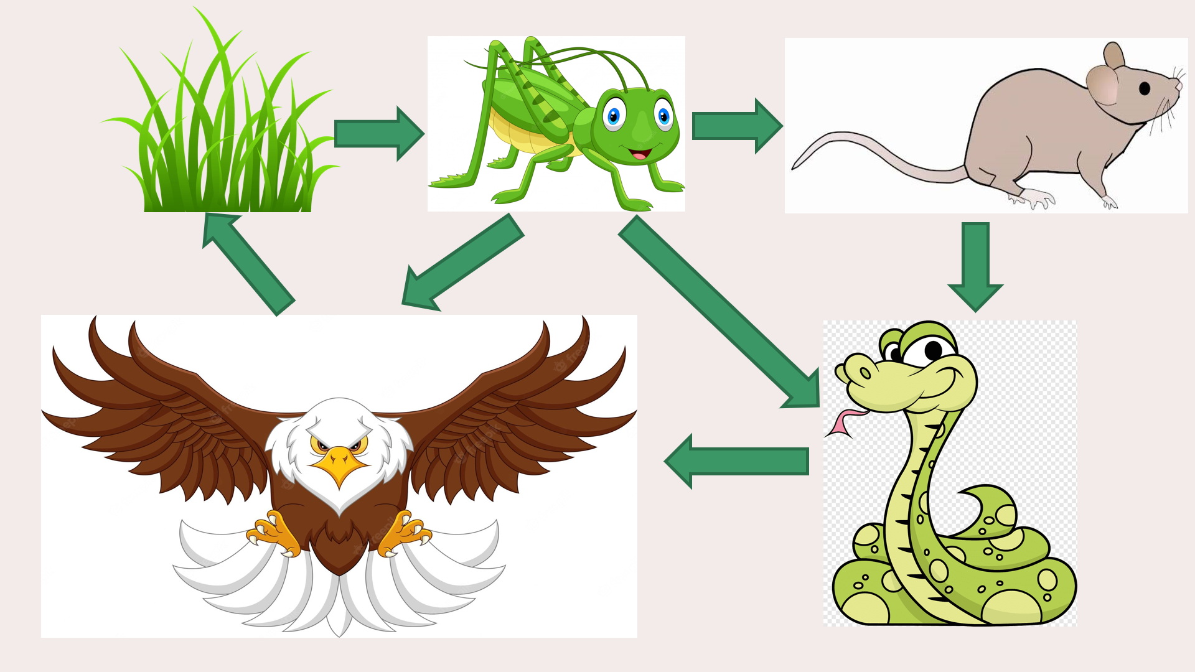
U9 [Vocabulary]
Lead-in to the third word
8/9
Slide advances by user
Navigation info:
NEXT=Third word (9/9)
Next word, now imagine in an environment, we just have the grass, the grasshoppers, the mouses, the snakes and the eagles. So can you tell me the relationship between them? How can they affect each others?
Okay, so you can see that the grass will be the food for the grasshoppers, the mouse will eat the grasshoppers, the snakes will eat the mouses, the eagles will eat the snakes and when the eagles die, their bodies will be turned into the materials to raise the grass.
And also the grasshoppers can also be the food for the snakes and the eagles, the mouses can also be the food for the eagles.
So we can call that the relationship of all the animals and how they affect each others in this environment is….

Slide 9
U9 [Vocabulary]
Third word
9/9
Slide advances by user
Navigation info:
Ecosystem.
So ecosystem is a noun to indicate all the living things in an area and the way they affect each other and the environment.
For example, the river’s ecosystem not only includes fish but other insects and plants.

