Slide 1
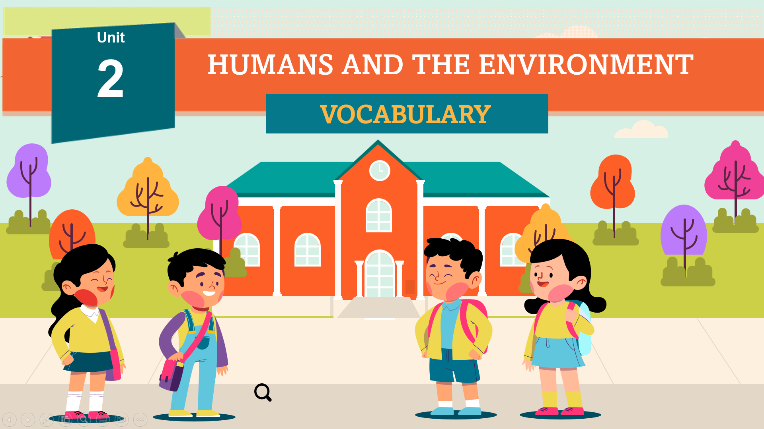
U2 [VOCABULARY]
Introduction
1/10
Slide advances by user
Navigation info:
NEXT=Lead-in to the first word (2/10)
Hello class, welcome to the Vocabulary Unit 2: Humans and the environment. Today we will learn some new words related to this section. Do not hesitate! Let’s get started!

Slide 2
U2 [VOCABULARY]
Lead-in to the first word
2/10
Slide advances by user
Navigation info:
NEXT=First word (3/10)
Okay the first one, look at the picture, can you tell me what are they?
Okay the first one is a TV, a television. The second one is a cooker and the third one is a fridge.
So we can call these three things are …

Slide 3
U2 [VOCABULARY]
First word
3/10
Slide advances by user
Navigation info:
NEXT=Lead-in to the second word (4/10)
Household appliance. So household appliance is a device which is used in the house, in Vietnamese we can call it thiết bị gia dụng.
For example, household appliances make housework easier.

Slide 4
U2 [VOCABULARY]
Lead-in to the second word
4/10
Slide advances by user
Navigation info:
NEXT=Lead-in to the second word (5/10)
Next one, can you tell me what makes light and runs a fan?

Slide 5
U2 [VOCABULARY]
Lead-in to the second word
5/10
Slide advances by user
Navigation info:
NEXT=Second word (6/10)
We need electricity to make light and run a fan, so where does electricity come from?

Slide 6
U2 [VOCABULARY]
Second word
6/10
Slide advances by user
Navigation info:
NEXT= Lead-in to the third word (7/10)
Okay, it comes from a kind energy, we need energy to run electricity.
So energy is the same meaning with power, in Vietnamese we call it năng lượng.
For example, these power stations provide energy to the nation.

Slide 7
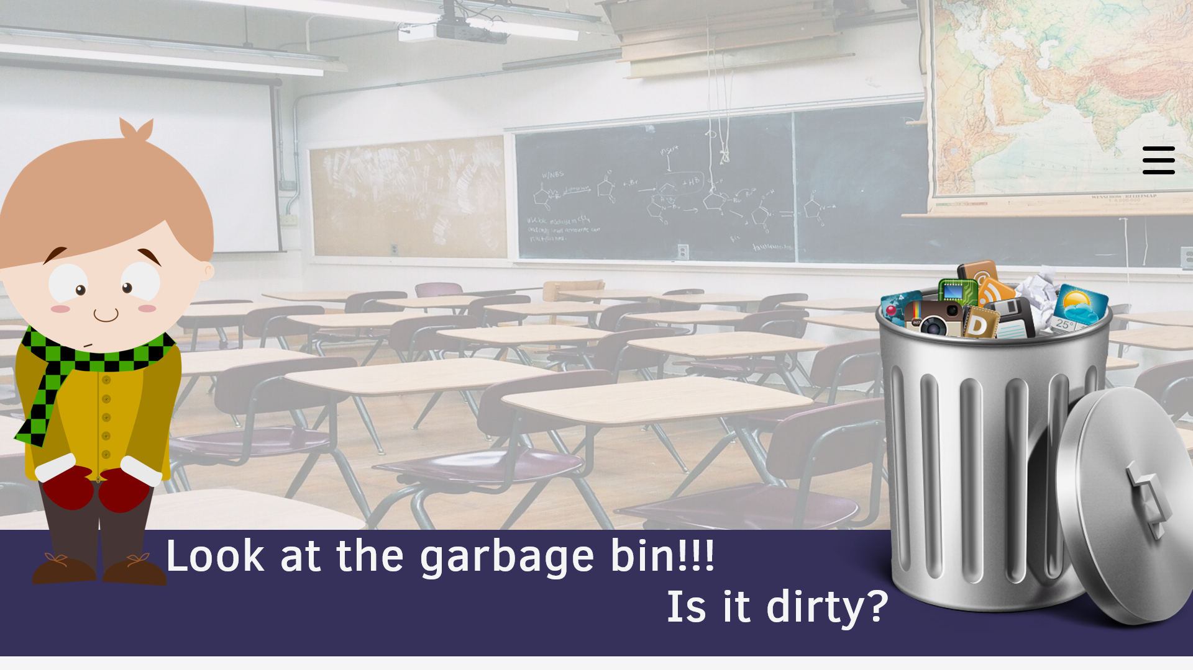
U2 [VOCABULARY]
Lead-in to the third word
7/10
Slide advances by user
Navigation info:
NEXT=Third word (8/10)
Next word, now look at the garbage bin. Is it dirty?
Yeah, it’s very dirty, full of appliances and garbage, right?
So we can call all the garbages in this bin is…

Slide 8
U2 [Vocabulary]
Third word
8/10
Slide advances by user
Navigation info:
NEXT= Lead-in to the fourth word (9/10)
Litter. Litter is a noun to indicate small pieces of rubbish
For example, Instead of plastic bags, he takes paper bags which are eco-friendly.

Slide 9
U2 [Vocabulary]
Lead-in to the fourth word
9/10
Slide advances by user
Navigation info:
NEXT=Fourth word (10/10)
Next one, so look at these two pictures, they are plastic bags and paper bags. So which one should be used and why?
Of course we should use paper bags right? So the reason why? Because they are friendly to the environment or we can call that paper bags are …

Slide 10
U2 [Vocabulary]
Fourth word
10/10
Slide advances by user
Navigation info:
Eco-friendly. So eco-friendly is an adjective, which means not harmful to the environment.
For example, Instead of plastic bags, he takes paper bags which are eco-friendly.
In Vietnamese, we can call it thân thiện với môi trường

