Slide 1
Unit 1: Family life
Here is where your presentation begins

Slide 2
Table of contents
1. PRONUNCIATION
2. VOCABULARY
3. GRAMMAR

Slide 3
1.PRONUNCIATION /br/, /kr/, /tr/

Slide 4
/br/
Bride
Bread
Bring

Slide 5
Cream
Crown
Crash
/kr/

Slide 6
/tr/
Train
Travel
Trick

Slide 7
Practice: Listen and repeat
/br/ | /kr/ | /tr/
breadwinner breakfast brown | crash crane cream | track tree train

Slide 8
2.VOCABULARY

Slide 9
Breadwinner /ˈbredˌwɪn.ər/ (n)
Ex: Men are often expected to be the breadwinner in a family.

Slide 10
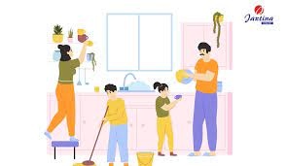
Chore /tʃɔːr/ (n)
Ex: I'll go shopping when I've done my chores

Slide 11
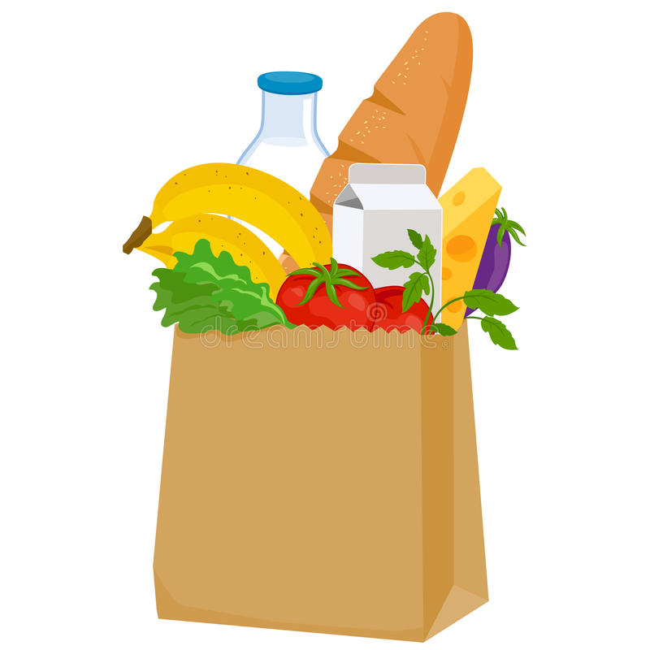
Groceries /ˈɡroʊ.sə.riz/ (n)
Ex: I was carrying three heavy bags of groceries.

Slide 12
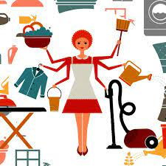
Homemaker /ˈhəʊmˌmeɪ.kər/ (n)
Ex: My mother is a homemaker.

Slide 13
Heavy lifting /ˌhev.i ˈlɪft.ɪŋ/ (n)
Ex: Fathers went off to factories and left the heavy lifting of child rearing to women.

Slide 14
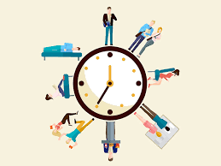
Routine /ruːˈtiːn/ (n)
Ex: Doing exercise is part of my daily routine.

Slide 15
3. GRAMMAR
Present simple vs present continuous

Slide 16
Present simple is used to talk about habits or things we do regularly
Present simple is used to talk about habits or things we do regularly
S + V (s/es)
S + do/ does + not + V
Ex: I play football everyday
Ex: I don’t play football everyday
Ex: Do you play football everyday

Slide 17
Present continuous is used to talk about things which are happening at the moment of speaking
S + is/ am/ are + V-ing | S + is/ am/ are + not + V-ing | Is/ Am/ Are + S + V-ing?
Ex: I am playing football now | Ex: I am not playing football now. | Ex:Are you playing football now?
Notes:
Present continuous is used to talk about things which are happening at the moment of speaking

Slide 18
Notes:
Time expressions:
Present simple: usually, always, every day, often, never, seldom…
Ex: My best friend usually go to school by bike.
Present continuous: now, at the moment, at present, …
Ex: He is listening to music at the moment.
We don’t usually use the present continuous tense with stative verbs (like, love, need, want, know, agree, etc.)
Ex: I want to go out. Not: I am not wanting to go out.
.

Slide 19
Thanks for listening!

