Slide 1
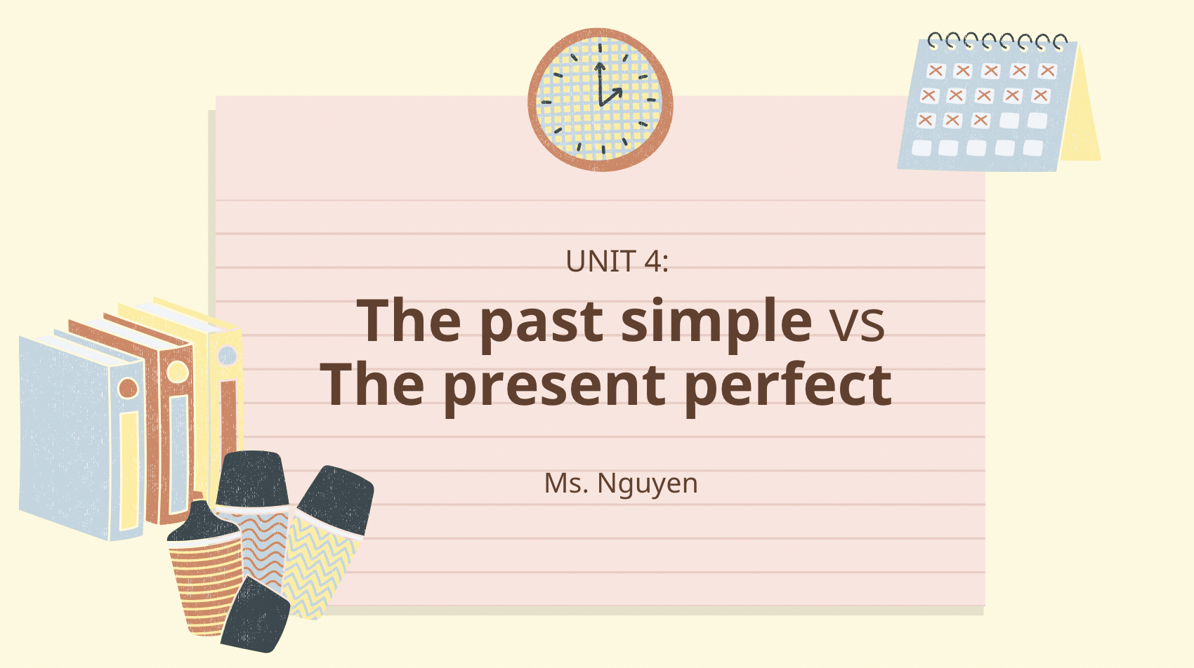
Project name: Grammar Unit 4 | Screen Title: Unit 4 – The past simple vs the present perfect | Screen #: 1/7
 |  | Graphic Info
 |  | Texts fade in when mentioned in the voiceover
 |  | Navigation
 |  | NEXT= past simple – present perfect (2/7)
 |  | Reviewer’s Comments
Audio: Hello everyone, I believe that you all have learned about the theory of the past simple and present perfect in the Lesson section. In this video I will show you the difference between the 2 tenses.

Slide 2
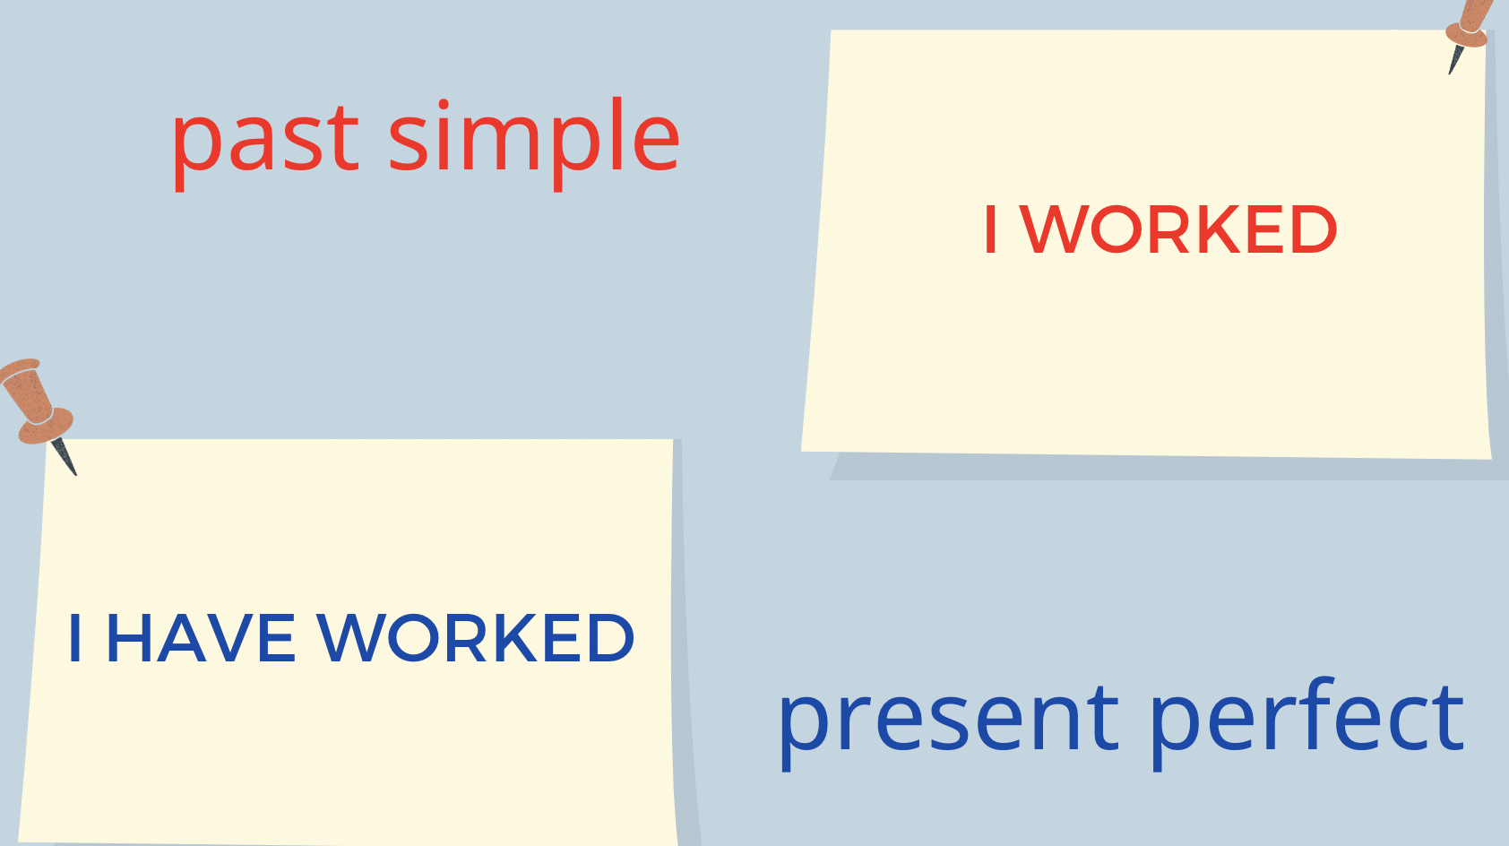
Project name: Grammar Unit 4 | Screen Title: past simple – present perfect | Screen #: 2/7
 |  | Graphic Info
 |  | Texts fade in when mentioned in the voiceover
 |  | Navigation
 |  | NEXT = Past simple (3/7)
 |  | Reviewer’s Comments
Audio: This is the examples of past simple and present perfect. I worked And I have worked

Slide 3
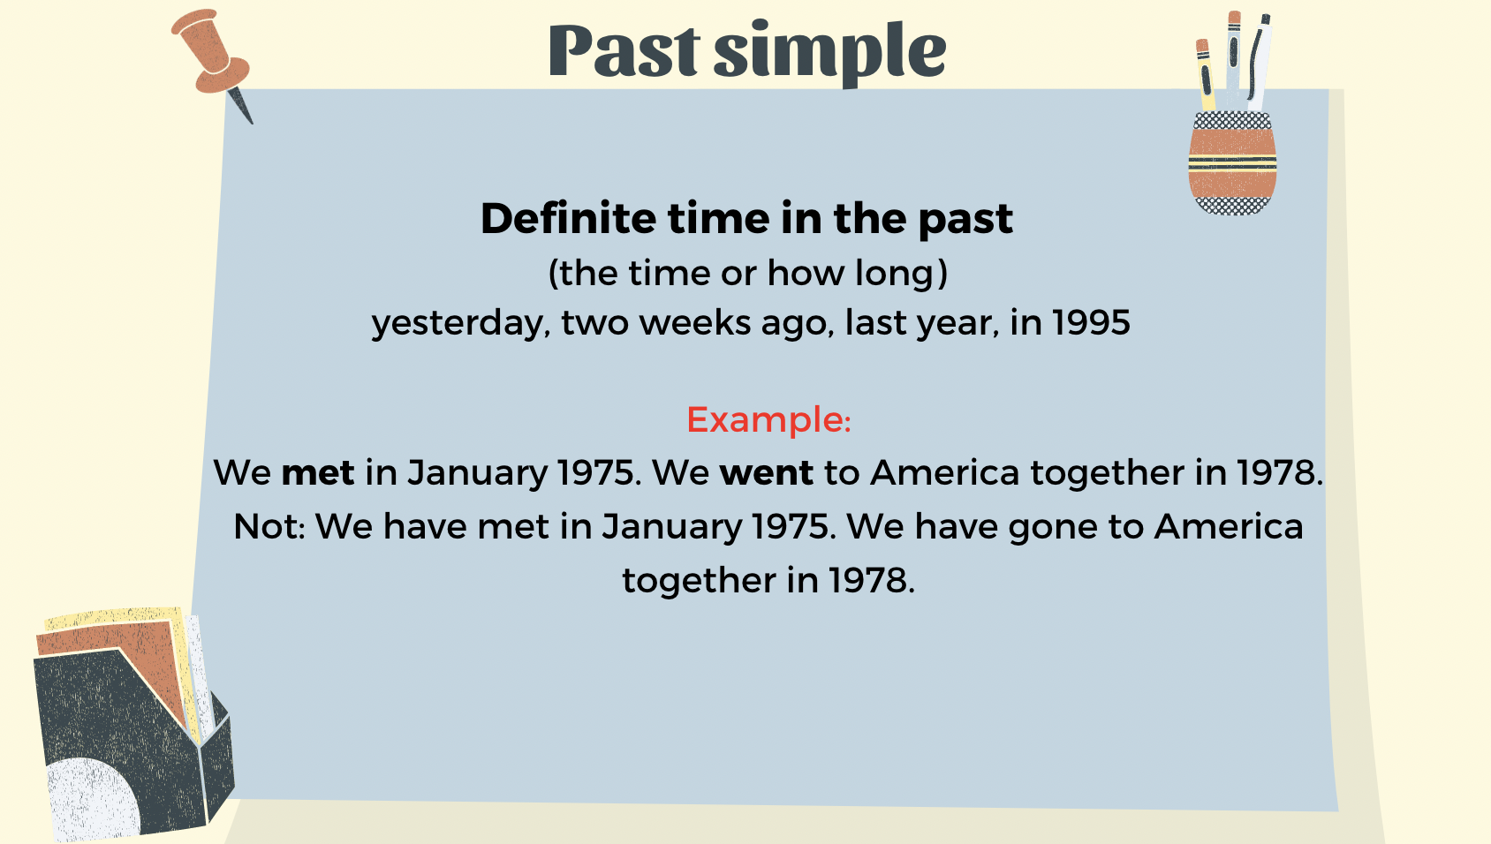
Project name: Grammar Unit 4 | Screen Title: Past simple | Screen #: 3/7
 |  | Graphic Info
 |  | Texts fade in when mentioned in the voiceover
 |  | Navigation
 |  | NEXT = Present perfect (4/7)
 |  | Reviewer’s Comments
Audio: So as what we have learned in the theory. We use the past simple to refer to definite time in the past (when we specify the time or how long) and usually with past time expressions such as yesterday, two weeks ago, last year, in 1995: We met in January 1975. We went to America together in 1978. Not: We have met in January 1975. We have gone to America together in 1978.

Slide 4
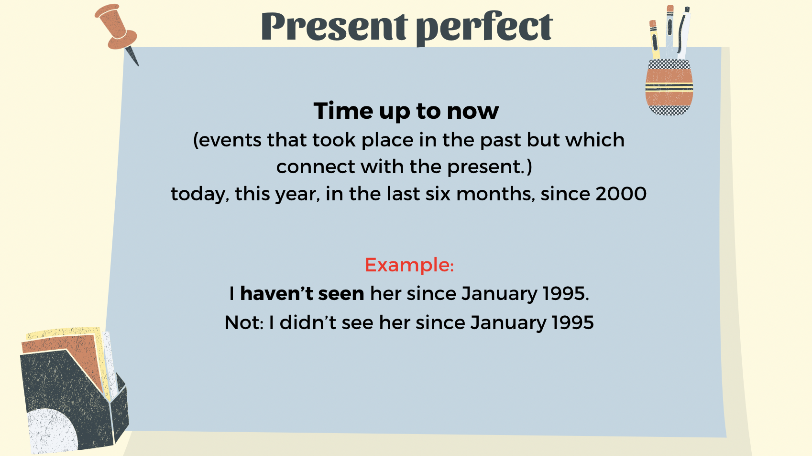
Project name: Grammar Unit 4 | Screen Title: Present perfect | Screen #: 4/7
 |  | Graphic Info
 |  | Texts fade in when mentioned in the voiceover
 |  | Navigation
 |  | NEXT = Compare (5/7)
 |  | Reviewer’s Comments
Audio: Time up to now We use the present perfect to talk about time up to now, that is, events that took place in the past but which connect with the present. The present perfect is often used with time expressions which indicate time up to now, for example today, this year, in the last six months: I haven’t seen her since January 1995. Not: I didn’t see her since January 1995

Slide 5
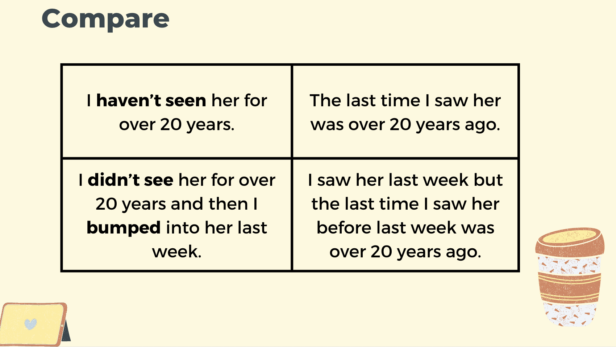
Project name: Grammar Unit 4 | Screen Title: Compare | Screen #: 5/7
 |  | Graphic Info
 |  | Texts fade in when mentioned in the voiceover
 |  | Navigation
 |  | NEXT = Compare (6/7)
 |  | Reviewer’s Comments
Audio: Next up, we will compare the past simple and present perfect I haven’t seen her for over 20 years. The last time I saw her was over 20 years ago. I didn’t see her for over 20 years and then I bumped into her last week. I saw her last week but the last time I saw her before last week was over 20 years ago.

Slide 6
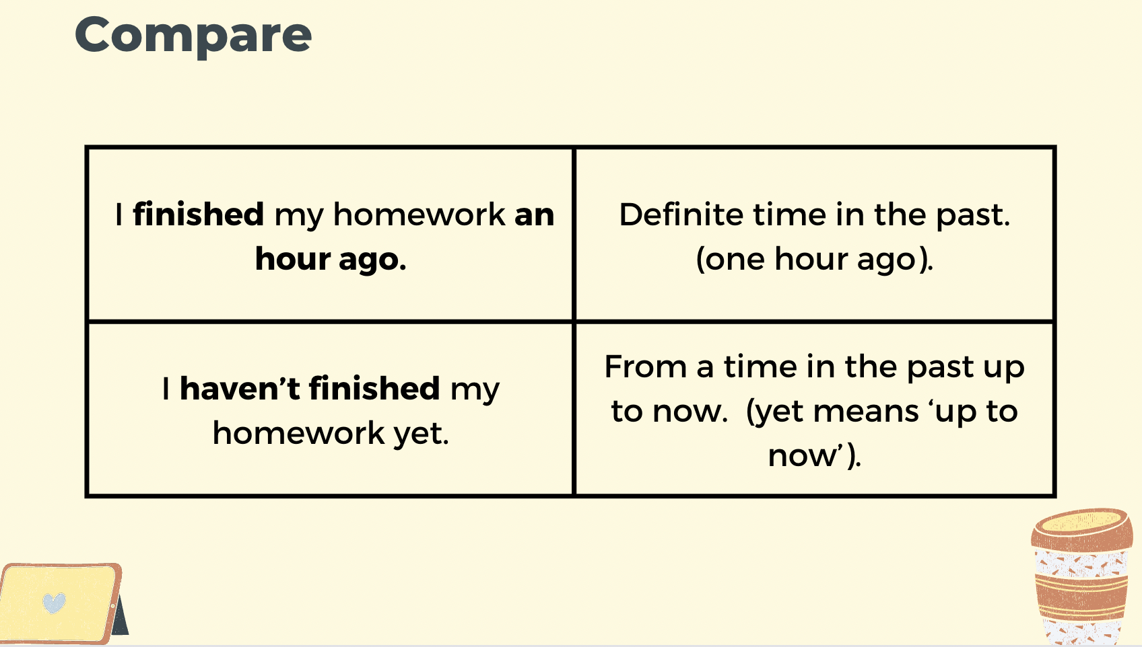
Project name: Grammar Unit 4 | Screen Title: Compare | Screen #: 6/7
 |  | Graphic Info
 |  | Texts fade at the beginning of the slide
 |  | Navigation
 |  | NEXT = See you in the next Lesson! (7/7)
 |  | Reviewer’s Comments
Audio: I finished my homework an hour ago. Definite time in the past. I finished my homework at a time in the past (one hour ago). I haven’t finished my homework yet. From a time in the past up to now. I started my homework at a time in the past and it is not finished yet (yet means ‘up to now’).

Slide 7
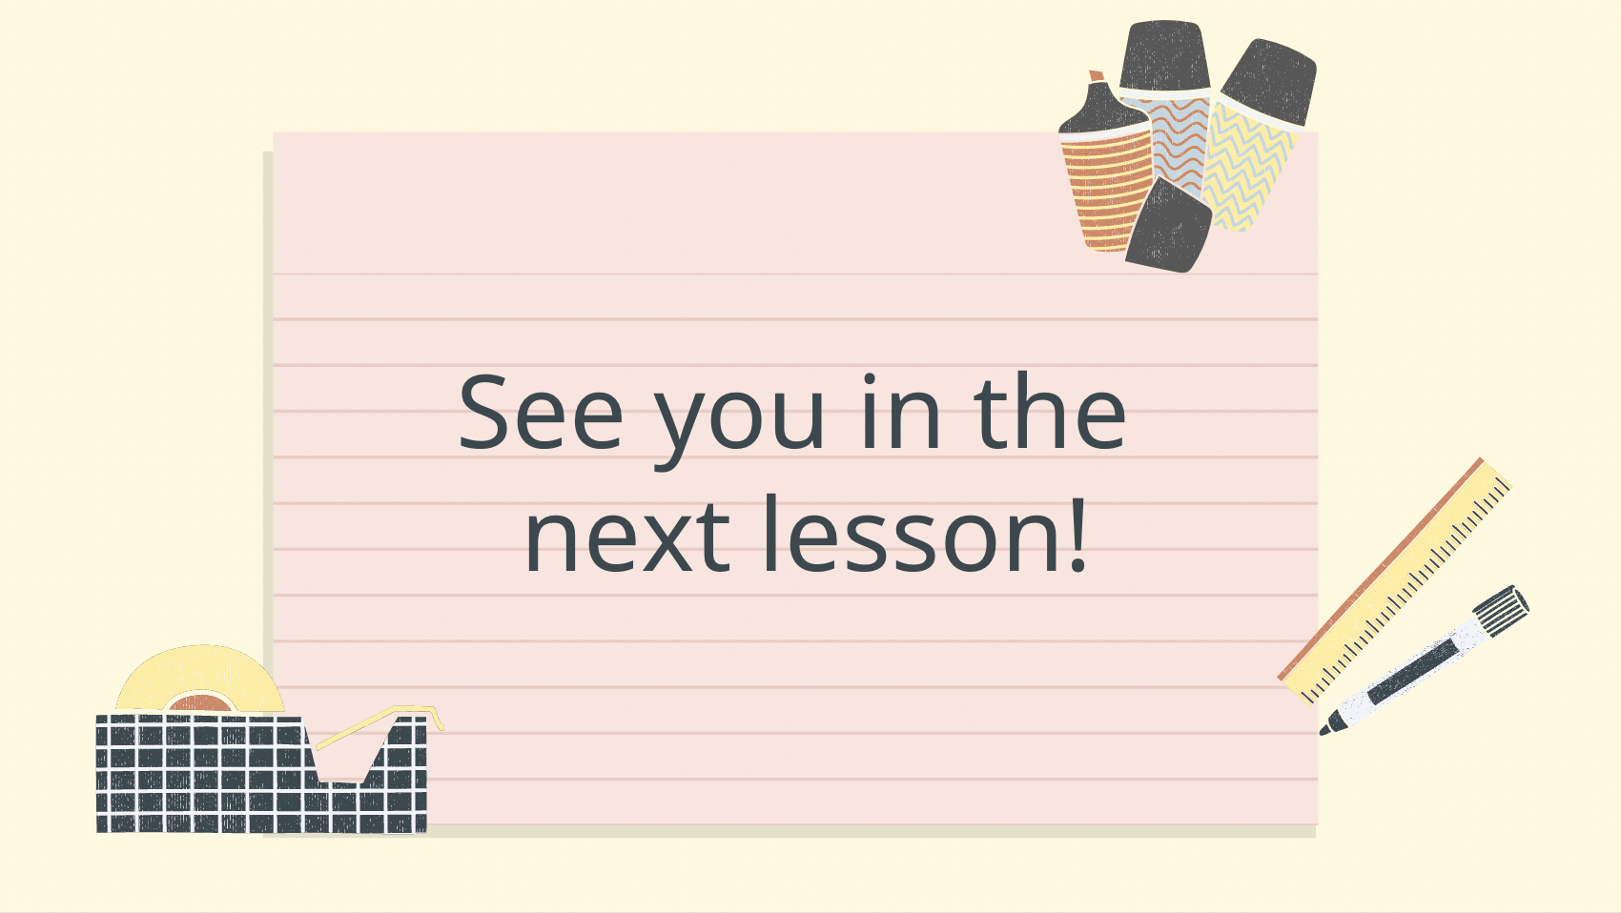
Project name: Vocabulary for Unit 1 | Screen Title: See you in the next lesson! | Screen #: 7/7
 |  | Graphic Info
 |  | Texts fade at the beginning of the slide
 |  | Navigation
 |  | NEXT = END OF VIDEO LECTURE
 |  | Reviewer’s Comments
Audio: And…, that’s the end of our lesson today. See you next time!

