Slide 1

Pronunciation – Unit 13
Introduction
1/3
Teacher are introducing the topic and lesson,
Texts are all appeared on the screen
Navigation info: NEXT = Teaching the first exercise of pronunciation
Hello class, now we will talk about Language focus of unit 13. In this lesson, we will talk about 2 main features, first one is Pronunciation and the second one is Grammar.

Slide 2
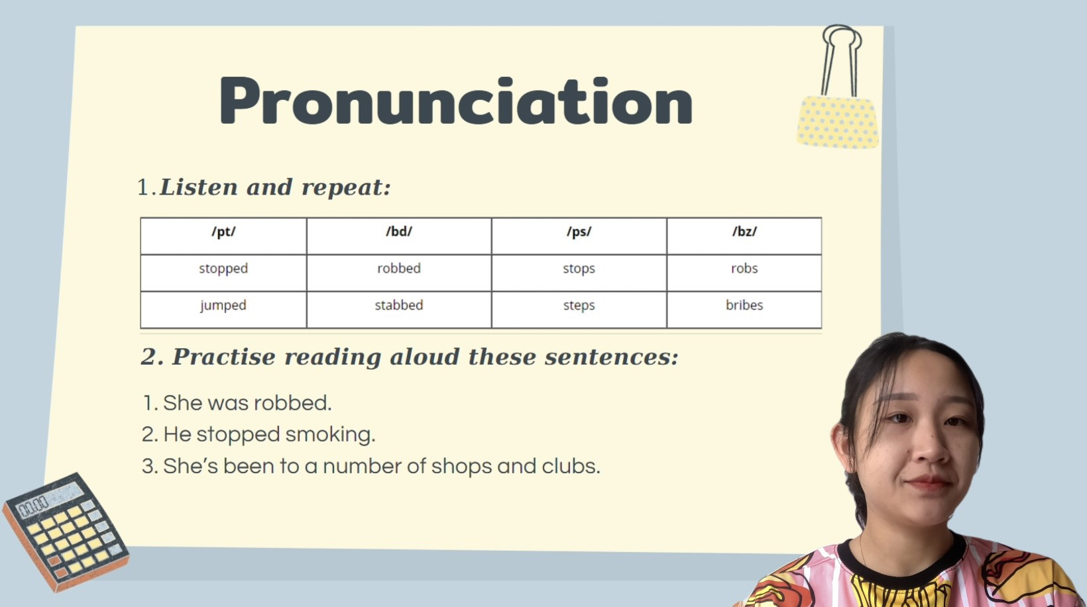
Pronunciation – Unit 13
Teaching the first activity
2/3
Teacher are showing and distinguishing 4 sounds: /pr/, /bd/, /ps/, /bz/
A table of sound and some examples.
Navigation info: NEXT = Teaching the second activity.
About the pronunciation, we will talk about 4 sounds, which are /pr/, /bd/, /ps/, /bz/. Look at the screen, we will practice pronounce some words which include these sound.
Repeat after me: perform.

Slide 3
Pronunciation
Teaching the second activity
3/3
Teacher are showing 3 sentences include 4 sounds to practice.
This is the last slide.
So this is the first activity, now we move to the second one which is “Practise reading aloud these sentences”.
On the screen, I give you guys 3 sentences, you have to practice these 3 sentences, okay?
Listen and repeat after me: Perform.

