Slide 1


Vocabulary
Unit 2:
Humans and the Environment

Slide 2
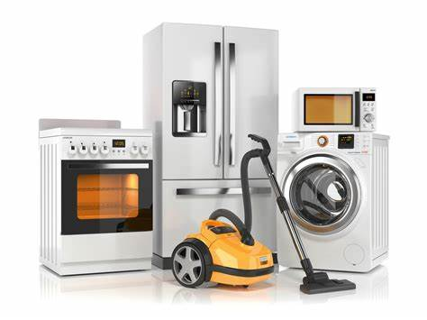
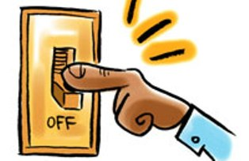
Household appliance (n):
/ˈhaʊs.həʊld əˈplaɪ.əns/
a device or machine, especially an electrical one that is used in the house
E.g. You should turn off household appliances when they are not in use.

Slide 3
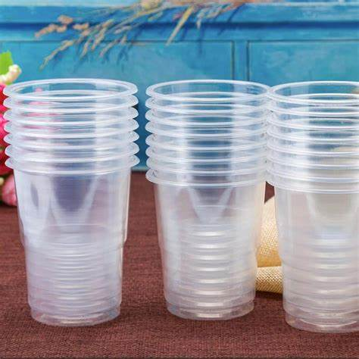
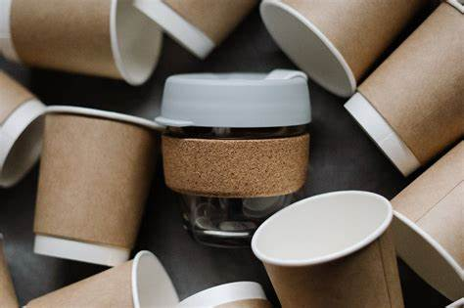
Eco-friendly (adj):
/ˈiː.kəʊˌfrend.li/
not harmful to the environment, or trying to help the environment
E.g. We should replace plastic cups with paper cups because they are more eco-friendly.

Slide 4
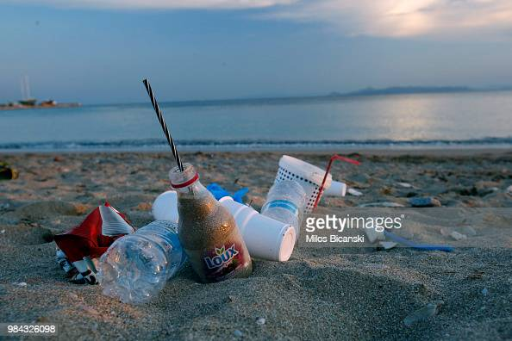
Litter (n):
/ˈlɪt.ər/
small pieces of rubbish that have been left lying on the ground in public places
E.g. The beach is full of litter of plastic cups after the party.

Slide 5
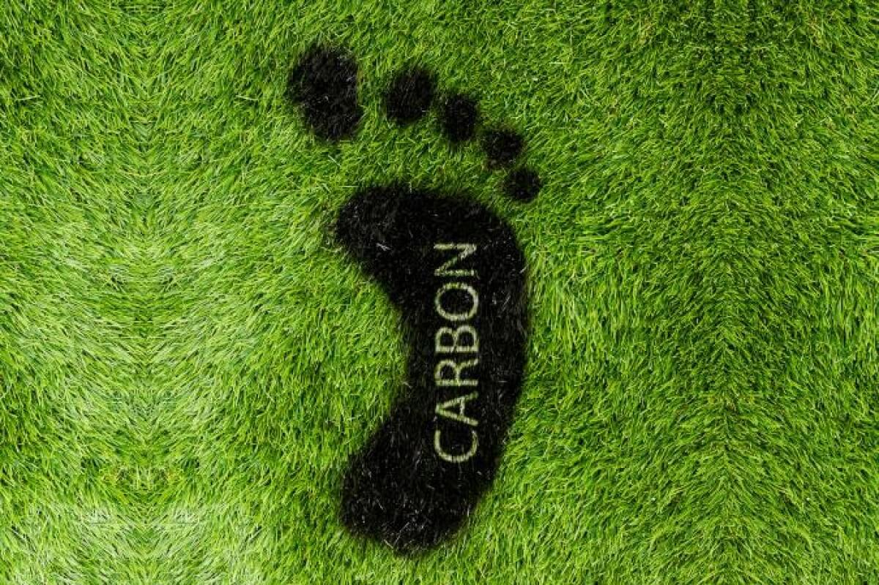
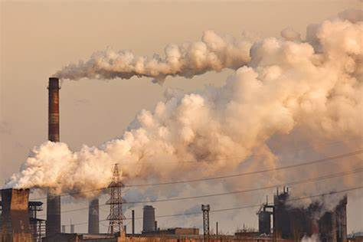
Carbon Footprint (n):
/ˌkɑː.bən ˈfʊt.prɪnt/
a measurement of the amount of carbon dioxide produced by the activities of a person, company, organization, etc.:
E.g. Government should take action to reduce the carbon footprint of factories.

