Slide 1
Linking vowels to vowels
Pronunciation​

Slide 2
Why linking vowels to vowels?
To create a smooth, fluid link from a word ending in a vowel sound into a word beginning with a vowel sound, a very small /y/ or /w/ is added between the words, connecting one word to the next. This allows both vowel sounds to occur individually, without stopping the airflow between words.

Slide 3
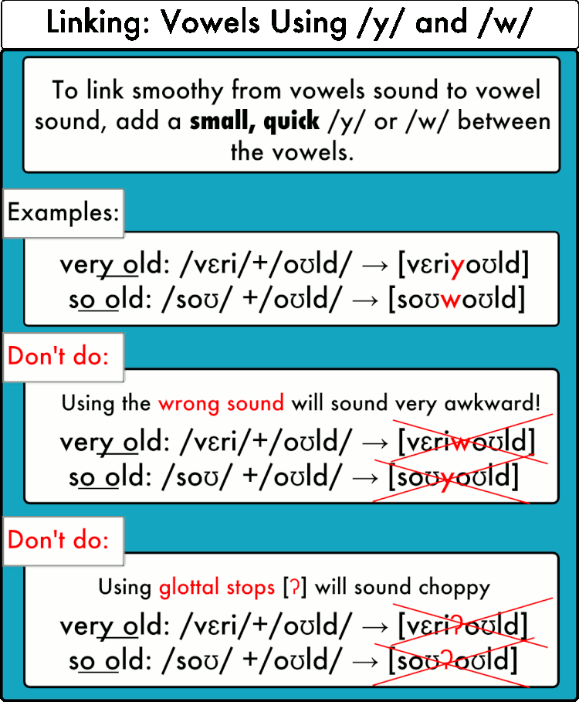
HOW TO LINK VOWEL TO VOWEL?

Slide 4
THANK YOU

