Slide 1
Conditionals type 3 & MIXED CONDITIONALS (TYPE 2 & TYPE 3)
UNIT 10 - Grammar ​

Slide 2
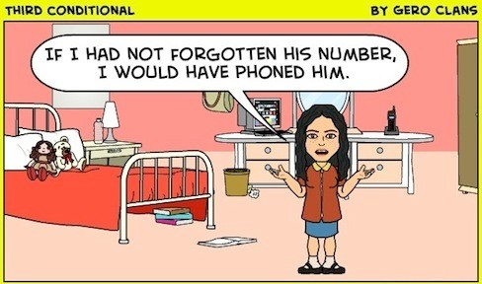
a. Conditionals type 3
1. USAGE
Conditionals Type 3 are used to talk about unreal or imaginary past activities or events.

Slide 3
a. Conditionals type 3
2. FORM
IF - CLAUSE | MAIN - CLAUSE
S + had V3/ed, (Past perfect) | S +would/could/might + have + V3/ed.
E.g
If Anna had passed the examination last month, she would have received the scholarship.
(Anna did not pass the examination.)

Slide 4
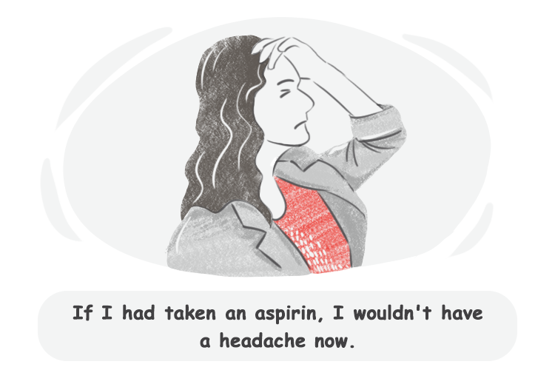
b. MIXED CONDITIONALS
1. USAGE
Mixed conditionals of Type 2 and Type 3 are used to talk about unreal or imaginary past activities, which have a present result.

Slide 5
b. MIXED CONDITIONALS
2. FORM
IF - CLAUSE | MAIN - CLAUSE
S + had V3/ed, (Conditional Type 3) | S + would +Infinitive. (Conditional Type 2)
E.g If Tom had studied harder last term, he would have a better job now.
(Tom did not study hard.)

Slide 6
b. MIXED CONDITIONALS
3. NOTE
In these mixed conditional sentences, you can also use modals in the main clause instead of would to express the degree of certainty, permission, or a recommendation about the outcome.
E.g
If you had crashed the car, you might be in trouble.
I could be a millionaire now if I had invested in ABC Plumbing.
If I had learned to ski, I might be on the slopes right now.

Slide 7
THANK YOU

