Slide 1

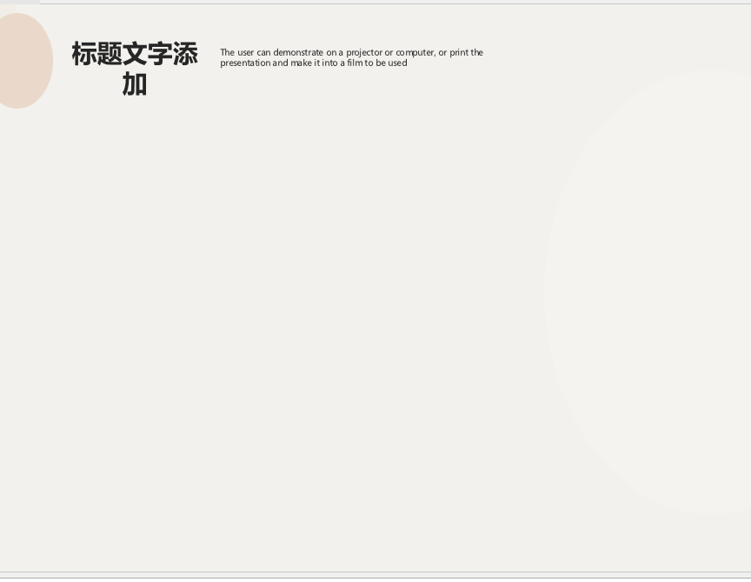
GRAMMAR UNIT 1
CONTENT
1/14
Text, a picture to decorate
CONTENT
PRESENT SIMPLE
Slide advanced by user.
Navigation:
Next= PRESENT SIMPLE (2/14)
PRESENT CONTINUOUS
Hi class, Today we will learn two grammar points that are quite similar with you.

Slide 2
GRAMMAR UNIT 1
PRESENT SIMPLE
2/14
Text, a picture to decorate
PRESENT
SIMPLE
TENSE
Slide advanced by user.
Navigation:
Next= PRESENT SIMPLE (Introduction) (3/14)
Now we have the first grammar point.

Slide 3


GRAMMAR UNIT 1
PRESENT SIMPLE (Introduction)
3/14
Text, characters, a picture, lines arrow
Slide advanced by user.
Navigation:
Next= Intro (cont.) (4/14)
I go to school everyday at 7a.m.
Now look at the Picture here, it is a …..Yes, it’s a school and a clock at 7 a.m. I can say, I go to school everyday at 7.a.m. To show that activity “go to school” repeats everyday . Now listen to me, pause the clip and repeat the sentence. I go to school everyday at 7a.m.

Slide 4

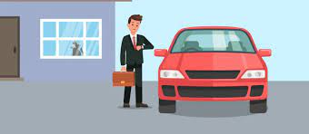
GRAMMAR UNIT 1
Intro (cont.)
4/14
Text, character, a picture, lines arrow
Slide advanced by user.
Navigation:
Next= Sentence Combination (5/14)
He always goes to work by car.
Now looking at the second picture, what is it? Exactly, it’s car, and a men there. I can say he always goes to work by car. To show that activity “go to work by car” repeats everyday. Now listen to me, pause the clip and repeat the sentence: he always goes to work by car

Slide 5
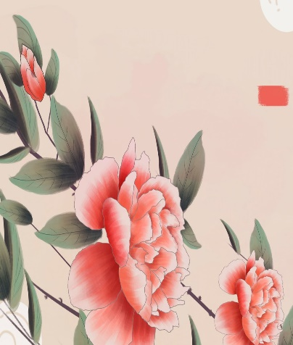
GRAMMAR UNIT 1
SENTENCE COMBINATION
5/14
SENTENCES COMBINATION
Text, a picture to decorate
I go to school everyday at
7a.m.
He always goes to work by car.
Slide advanced by user.
Navigation:
Next= FORM (Structure + use + note) (6/14)
Here are these examples.

Slide 6

GRAMMAR UNIT 1
FORM( structure + use + note)
6/14
FORM
Text, a picture to decorate
S +V0/s/es + (O)
Slide advanced by user.
Navigation:
Next= Examples (7/14)
Use: The present simple is used to talk about daily habits and routines.
*NOTE: I, you, we, they + V0
He, she, it +Vs/es
- commonly adverbs used in present simple tense always, usually, seldom, never, sometimes, often, everyday,….
From two examples: we have a structure for present simple tense like this. Form: S +V0/s/es
The present simple is used to talk about daily habits and routines. With I you, we, they + V0. He, she,it +Vs/es
you need to pay attention to some commonly adverbs used in present simple tense always, usually, seldom, never, sometimes, often, everyday,….

Slide 7

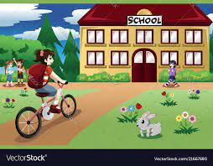
GRAMMAR UNIT 1
EXAMPLES
7/14
Text, a picture to decorate
I go swimming everyday..
EXAMPLES
Slide advanced by user.
Navigation:
Next= PRESENT CONTINUOUS (8/14)
She sometimes rides a bike to school.
Another Ex: Can you see a picture? I say that “ I go swimming everyday”
The second picture, I say She sometimes rides a bike to school.

Slide 8
GRAMMAR UNIT 1
PRESENT CONTINUOUS
8/14
Text, a picture to decorate
PRESENT CONTINUOUS
Slide advanced by user.
Navigation:
Next= PRESENT CONTINUOUS (Introduction) (9/14)
Now we move onto the second grammar.

Slide 9
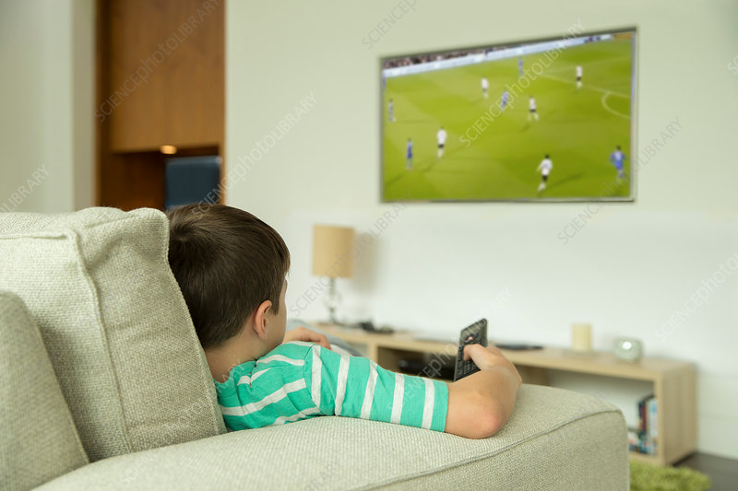
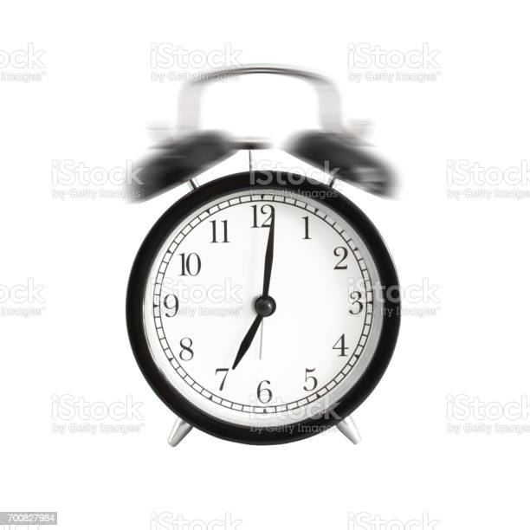
GRAMMAR UNIT 1
PRESENT CONTINUOUS (Introduction)
9-14
Text, character, a picture, lines arrow
Slide advanced by user.
Navigation:
Next=Intro (cont.) (10/14)
He is watching TV now.
Look at this picture, I can see now the time is 7p.m, the boy and a Tv, to show the thing is happening at the same time when I’m speaking I can say he is watching TV now. Now listen to me, pause the clip and repeat he is watching TV now.

Slide 10


GRAMMAR UNIT 1
Intro (cont.)
10/14
Text, character, a picture, lines arrow
Slide advanced by user.
Navigation:
Next=SENTENCES COMBINATION(11/14)
I am doing homework at present.
And from this picture, the time now is 8pm, I can say I am doing homework at present. Now listen to me, pause the clip and repeat I am doing homework at present.

Slide 11
GRAMMAR UNIT 1
SENTENCE COMBINATION
11/14
SENTENCES COMBINATION
Text, a picture to decorate
He is watching TV now.
I am doing homework at present.
Slide advanced by user.
Navigation:
Next= FORM (structure+meaning+use) (12/14)
Here are these examples.

Slide 12

GRAMMAR UNIT 1
FORM( structure + neaming+ use)
12/14
FORM
Text, a picture to decorate
S + be(am/is/are)+ V-ing + (O)
Slide advanced by user.
Navigation:
Next= FORM (notes) (13/14)
MEANING:…….đang làm gì…..
USE: The present continuous is used to talk about something that is happening or not happening at the moment of speaking.
From two examples: we have a structure for present continuous like this
Form S + be (am/is,are)+ v-ing
- The present continuous is used to talk about something that is happening or not happening at the moment of speaking.

Slide 13
GRAMMAR UNIT 1
FORM (Notes)
13/14
FORM
Text, a picture to decorate
*NOTES: I + am
You, we, they + are
He, she, it + is
+ some adverb clues about present continuous: now, at the moment, at present
Slide advanced by user.
Navigation:
Next= Examples (14/14)
With I + am, You,We,they + are, he, she, it +is
some adverb clues about present continuous: now, at the moment, at present

Slide 14

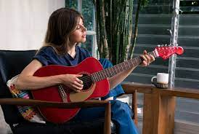
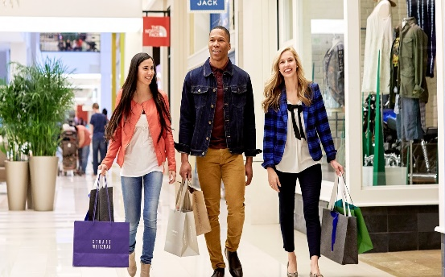
GRAMMAR UNIT 1
EXAMPLES
14/14
EXAMPLES
Text, character, a picture, lines arrow
Slide advanced by user.
I am walking at present.
We are going shopping now.
She is playing the guitar at the moment.
Here are some examples. I am walking at present
She is playing the guitar at the moment.
We are going shopping now.

