Slide 1
Unit 1
Family Life
Vocabulary

Slide 2
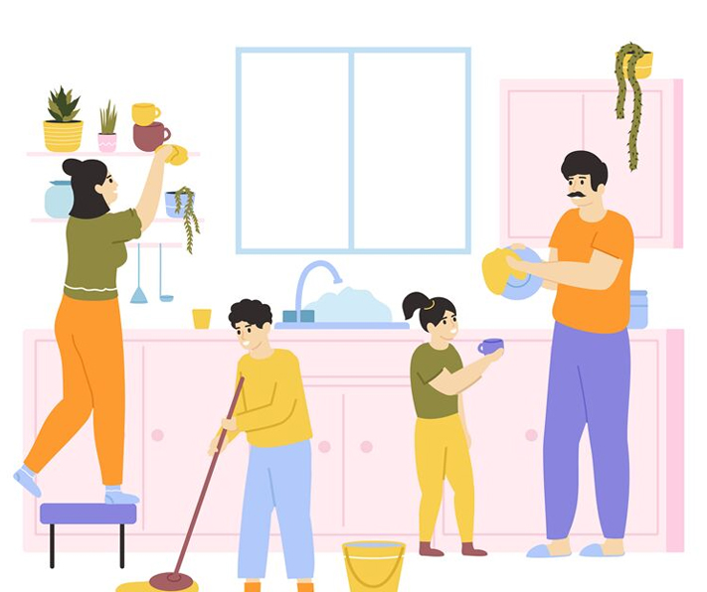
Chores (n)
Tasks that you do often, especially a household ones

Slide 3

Breadwinner (n)
A person who supports their family with the money they earn

Slide 4
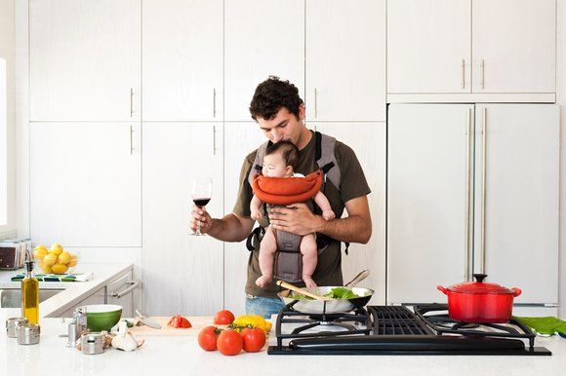
Homemaker (n)
A person who manages the home and raise children, instead of earning from a job

Slide 5

Split (v)
= Divide

Slide 6

Heavy lifting (n)
An action that requires physical strength

Slide 7
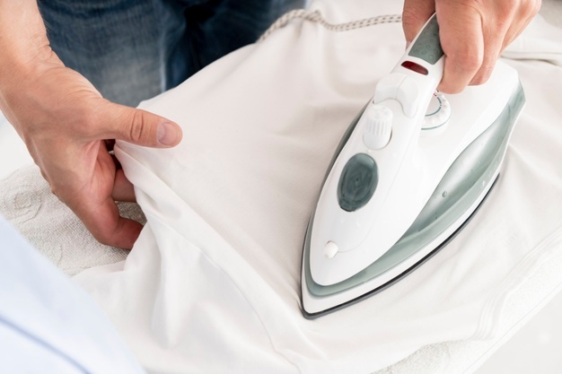
Iron (v/n)
To make clothes smooth by using an iron

Slide 8
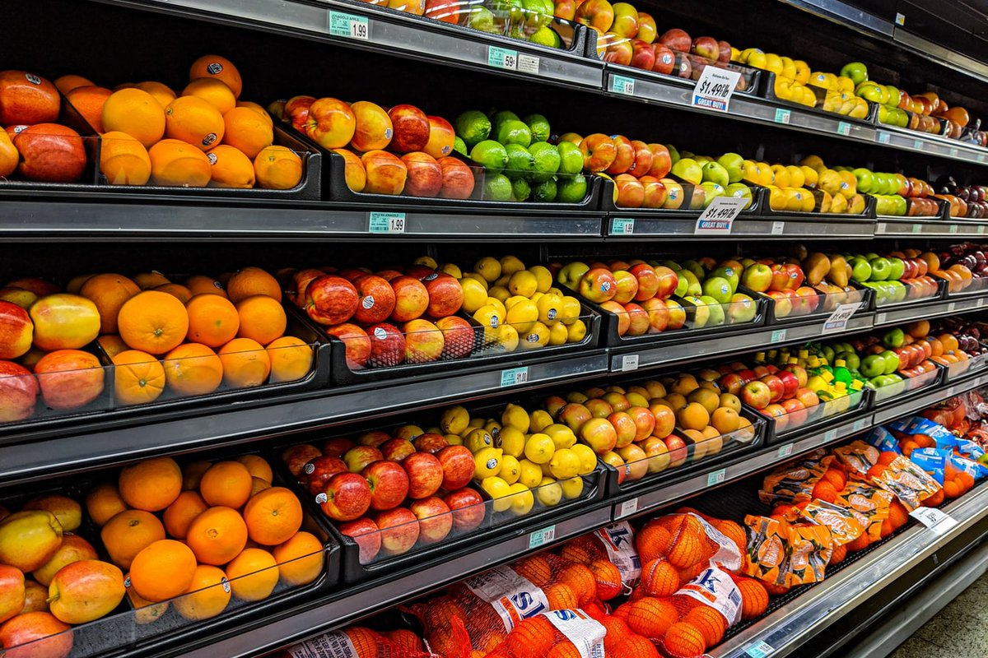
Groceries (n)
Food and other goods that are used in the home in everyday life.

Slide 9

sweep (v)
To clean a room, surface using a broom/brush

Slide 10

routine (n)
The normal order and way in which you regularly do things

Slide 11
Vocabulary summarry
Chores (n)
Breadwinner (n) | Homemaker (n)
Split (v) | Iron (v)
Heavy lifting (n) | Groceries (n)
Sweep (v) | Routine (n)

Slide 12
See you in the next lesson!

