Slide 1
Unit7: Cultural Diversity
Speaking:
Traditions around the world

Slide 2
Objectives:
By the end of this lesson, you will be able to:
Know more about traditions and customs of the UK and Russia and can talk about them.
Give a mini talk about some cultural aspects of Vietnam.

Slide 3
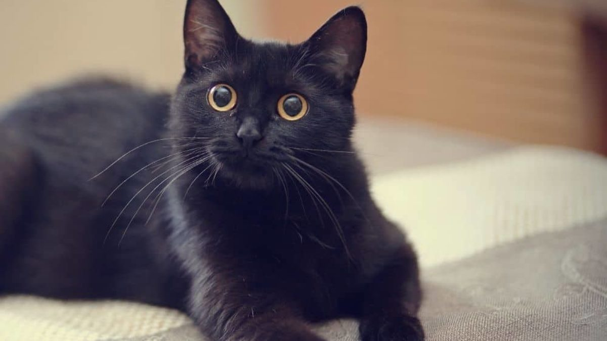
Superstition (n)
= an unscientific belief
/suːpəˈstɪʃ.ən/
Black cats are often considered a superstition and are often less likely to be adopted from shelters.

Slide 4
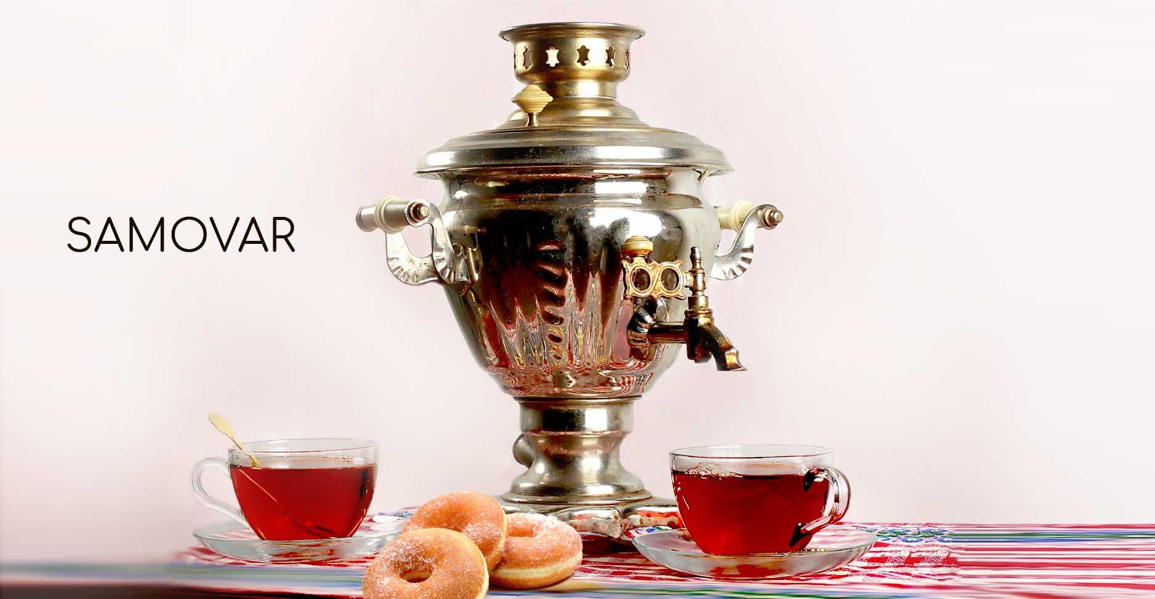
Samovar (n)
= a container used to boil water for tea.
/ˈsæməvɑːr/
Samovars are widely used in Russia.

Slide 5
What am I thinking of?
Let’s play
Black cats | Pay attention | Magpie
Superstition | Table manners | Break a mirror
Fish and chips | Knife | Tradition
Figure skating | Fork | Whistle
Samovar | Spoon | Scatter

Slide 6
Activity 1: Do the quiz, using your background knowledge
1. The sandwich was invented in ...
a. Russia b. The UK
2. People believe that black cats will bring bad luck in ...
a. Russia b. The UK
3. In ... it is believed that the bride should wear ‘something borrowed, something blue, something old and something new’, for good luck.
a. Russia b. The UK
4. People in ... believe that ‘money goes to money’.
a. Russia b. The UK

Slide 7
Whoa!
Well done! Bravo!

Slide 8
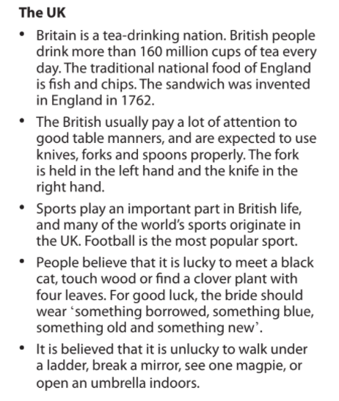
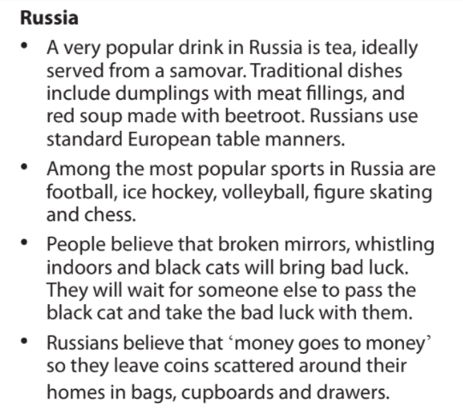
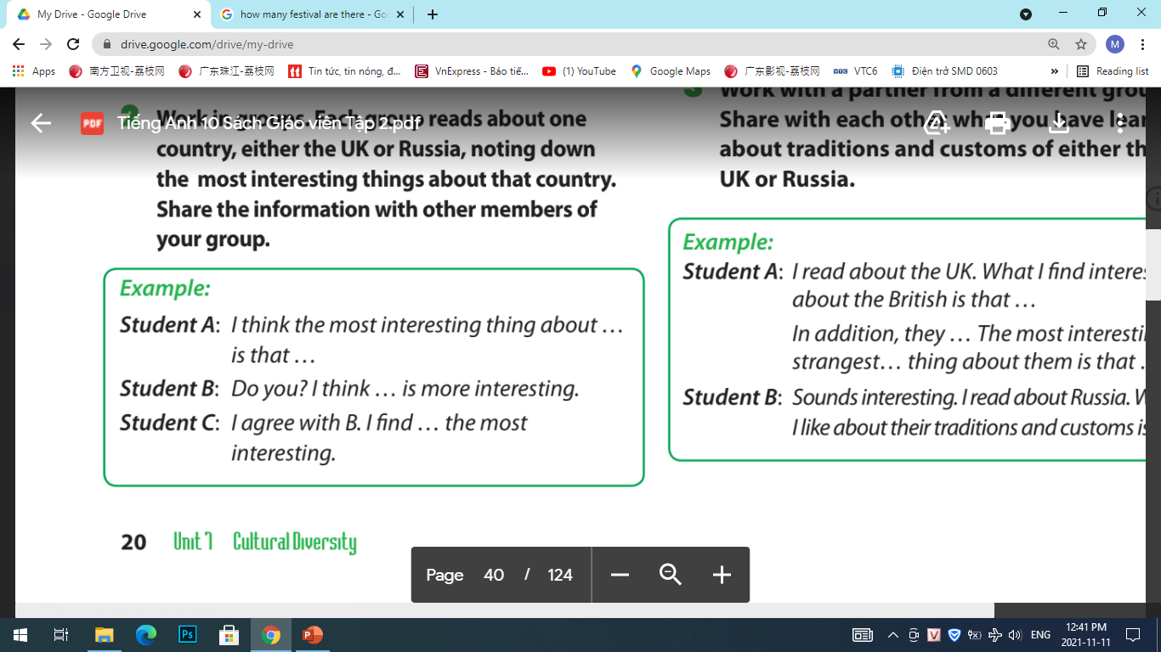
Activity 2: Work in groups

Slide 9
Activity 2: Work in groups

Slide 10
Activity 2: Work in groups

Slide 11
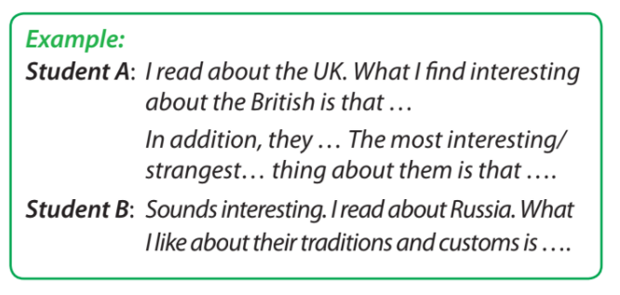
Activity 3:

Slide 12
Activity 3:

Slide 13
Activity 4: Let’s rank these festivals in the order of popularity and present them to the whole class.
Christmas
Tet holiday
Mid-autumn festival
Example:
Student A: I think the most popular festival in Vietnam is… …. It last longer than any other festivals.
Student B: Oh really? For me, … is the most popular.
Student C: I don’t really think so. … is more popular than ….

Slide 14
Thank you!

