Slide 1
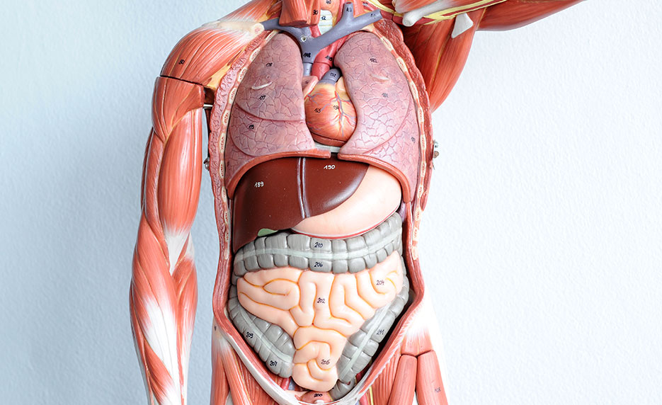

Slide 2
Unit 8 YOur boDY AND YOU

Slide 3
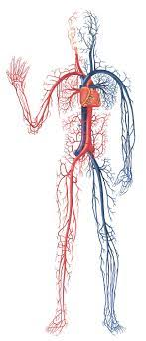
circulatory system /ˈsɝː.kjə.lə.tɔːr.i/ /ˈsɪs.təm/ (np)

Slide 4
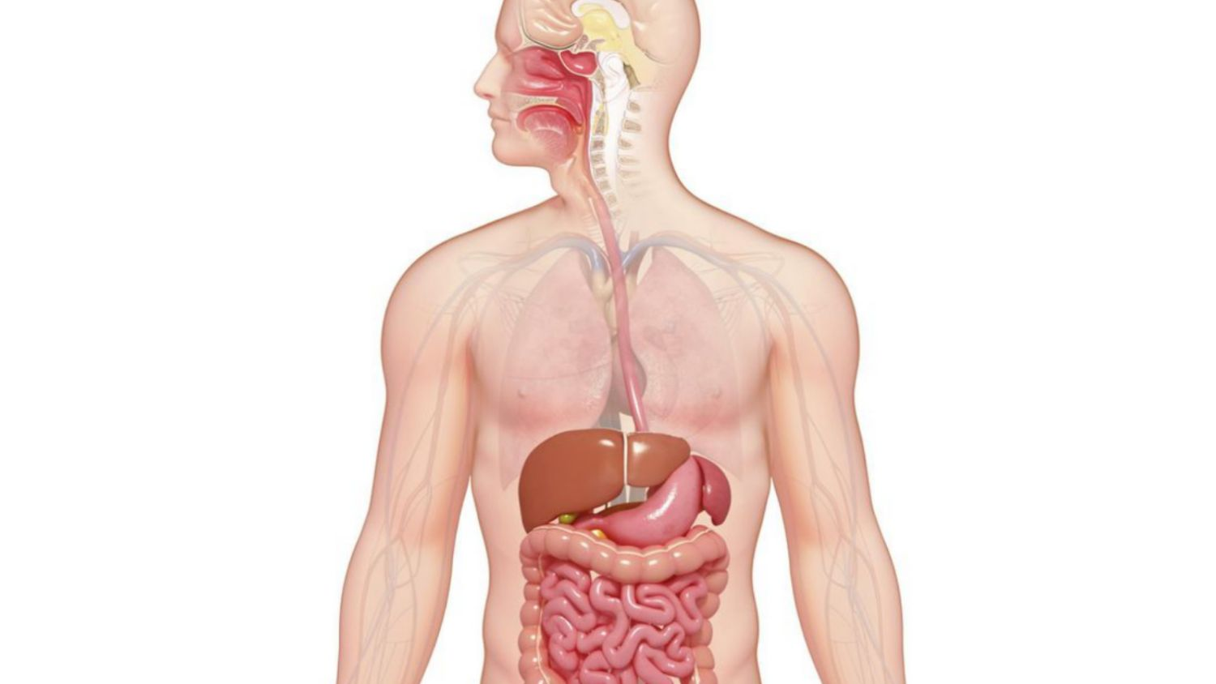
digest /daɪˈdʒest/ (v)
=> digestive system /daɪˈdʒes.tɪv/ system (np)

Slide 5
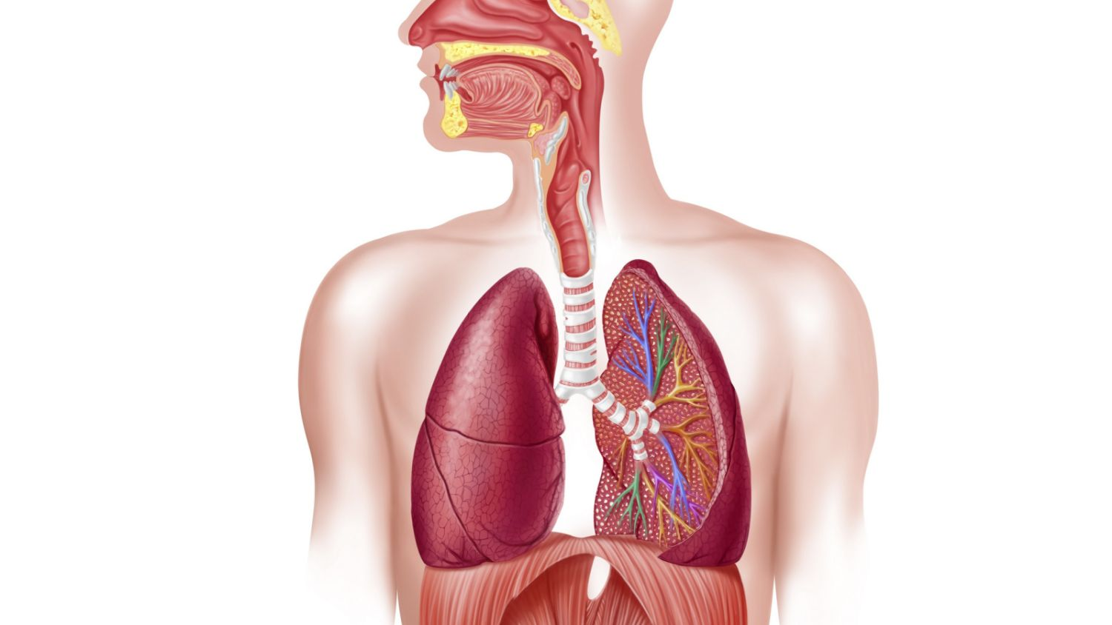
respriratory /ˈres.pə.rə.tɔːr.i/ system (np)

Slide 6
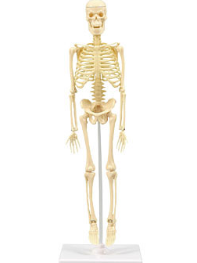
skeletal /ˈskel.ə.t̬əl/ system (np)

Slide 7
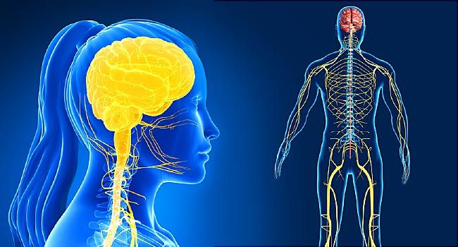
nervous system /ˈnɝː.vəs ˌsɪs.təm/ (np)

