Slide 1
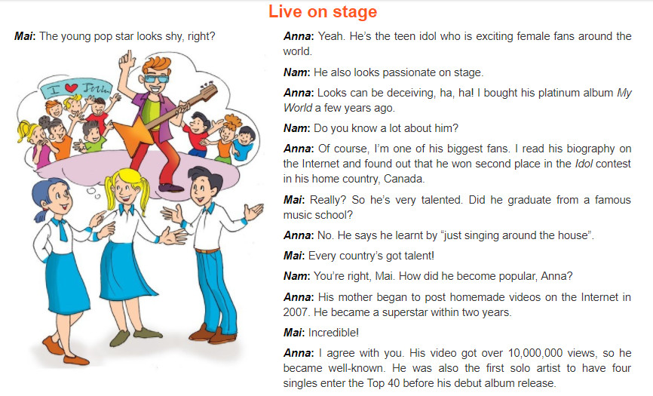
LISTEN AND READ THE CONVERSATION

