Slide 1
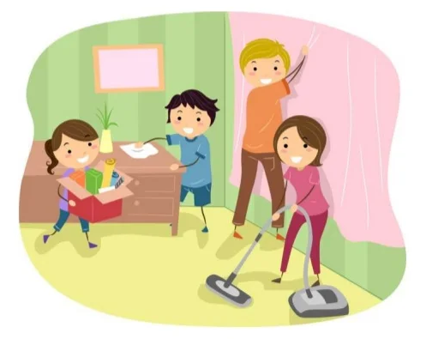
Unit 1: family life
vocabulary

Slide 2
Homemaker (n) /ˈhəʊmˌmeɪ.kər/
A person who manages a home and often raises children instead of earning money from a job

Slide 3
Household chores (np) /ˈhaʊs.həʊld tʃɔːrz/
Housework/Tasks such as cleaning, washing, and ironing that have to be done regularly at home

Slide 4
Breadwinner (n) /ˈbredˌwɪn.ər/
The member of a family who earns the money that the family needs

Slide 5
Groceries (n) /ˈgrəʊsəriz/
The products that you buy in a store such as food
=> Shop for groceries

Slide 6
Equal (adj) /ˈiː.kwəl/
the same in amount, number, or size
=> equally (adv)

Slide 7
Laundry (n) /ˈlɔːn.dri/
Clothing, bed sheets, etc., That need to be washed
=> To do the laundry: to wash, and clean the dirty clothes

Slide 8
To do the washing-up
To wash the dishes

Slide 9
To put out the rubbish
To take the rubbish out of your house

Slide 10
Heavy lifting (n) /ˈhɛvi ˈlɪftɪŋ/
the act of picking up and carrying heavy objects
=> do heavy lifting

Slide 11
Routine (n) /ruːˈtiːn/
Works that you do every day

