Slide 1
Correct tasks - Discussion
Introduction
1/12
Slide advances by user
NEXT = Word “Breadwinner”
After watching the vocabulary clip, now we come to the first task: Read the following text and answer these 2 questions.

Slide 2
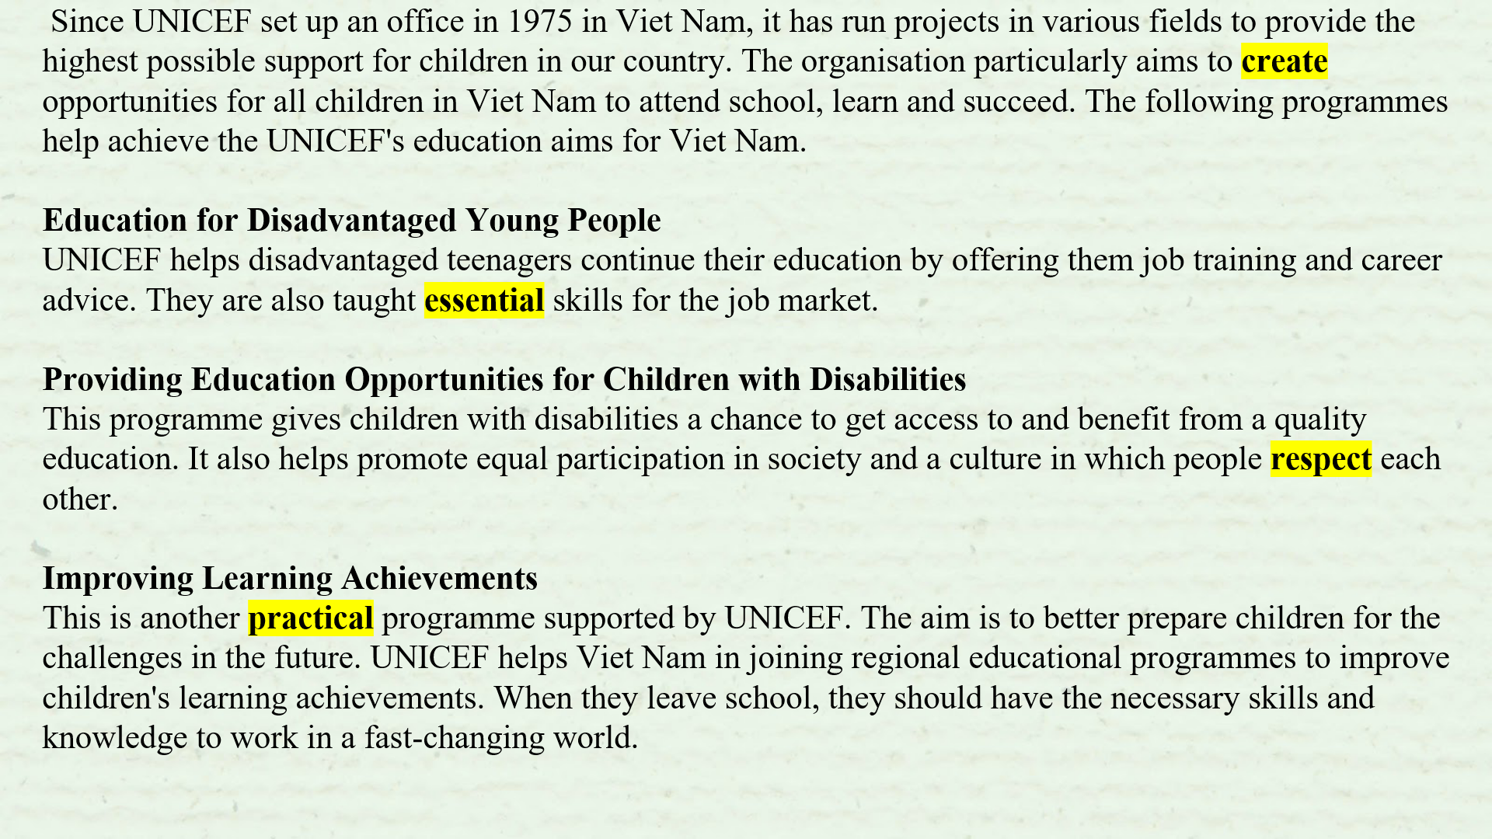
Correct tasks - Discussion
Task 1
2/12
Slide advances by user
NEXT = Word “Homemaker”
Read this text quickly and answer the 2 questions above. You can stop the video when doing the task.
Yes, first question: How many programmes does UNICEF use to support Viet Nam’s education? – Yes, the answer is 3 and What are they? And this is the evidence.

Slide 3
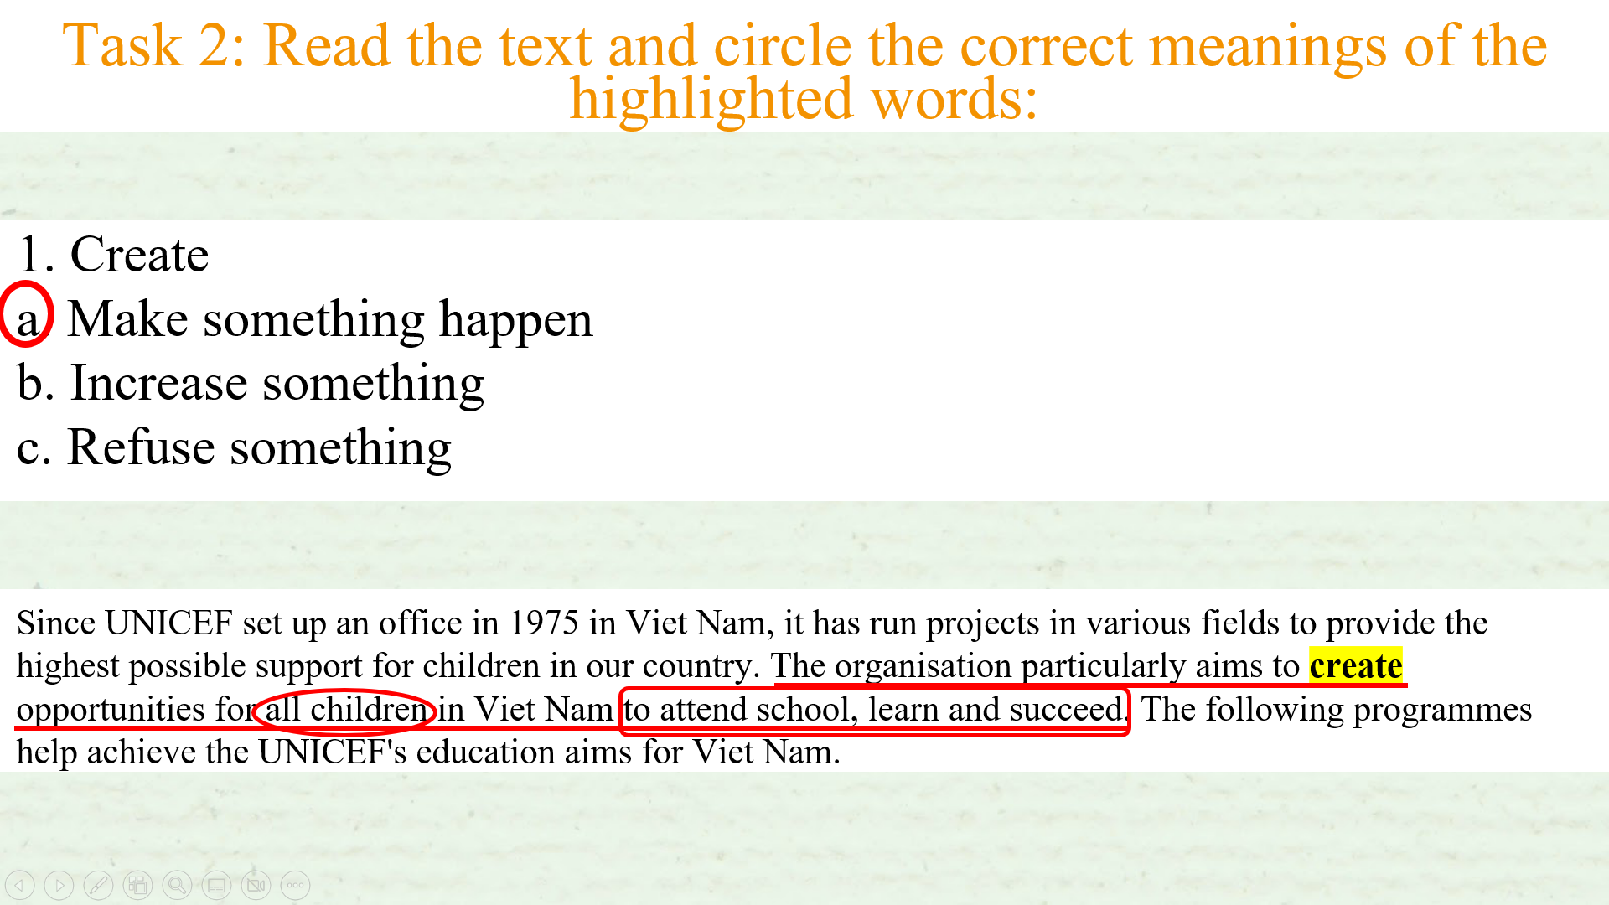
Correct tasks - Discussion
Task 2
3/12
Slide advances by user
NEXT = Word “Groceries”
Come to task 2. Read the text again and circle the correct meanings of the highlighted words. You can stop the video when you do this.
And the answer is A and you can find the evidence in paragraph 1.

Slide 4
Correct tasks - Discussion
Task 2
4/12
Slide advances by user
NEXT = Word “Heavy lifting”
Next answer in question 2 is B. And you can find the evidence in the “Education for Disadvantaged Young People”

Slide 5
Correct tasks - Discussion
Task 2
5/12
Slide advances by user
NEXT = Thanks
A is the answer for question number 3. And the evidence is in the “ Providing Education Opportunities for Children with Disabilities” section.

Slide 6
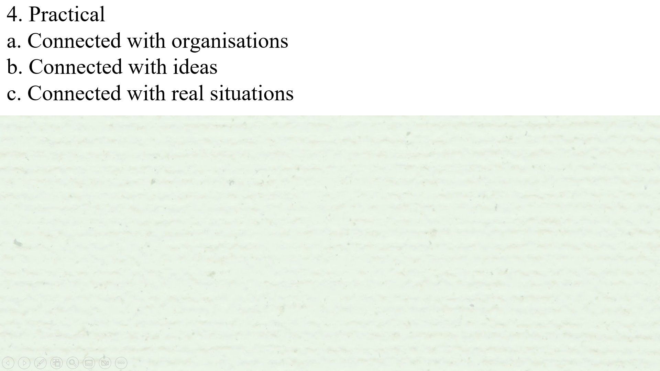
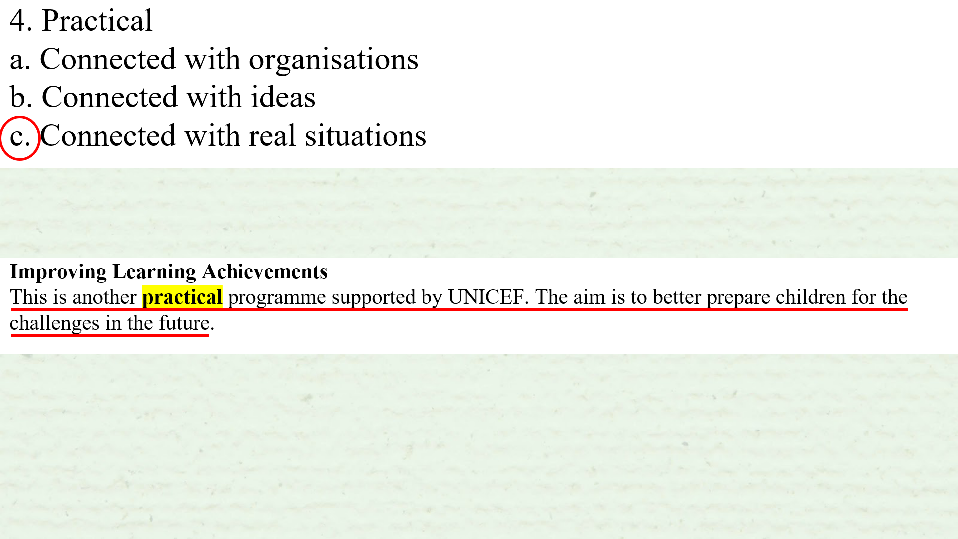
Correct tasks - Discussion
Task 2
6/12
The answer for the last question in task 2 is C. And the evidence is also the last paragraph. Quickly correct the answer in your handout.

Slide 7
Correct tasks - Discussion
Task 3
7/12
Now come to task number 3, read the text one more time to full fill this big table. You can stop the video when doing the task

Slide 8
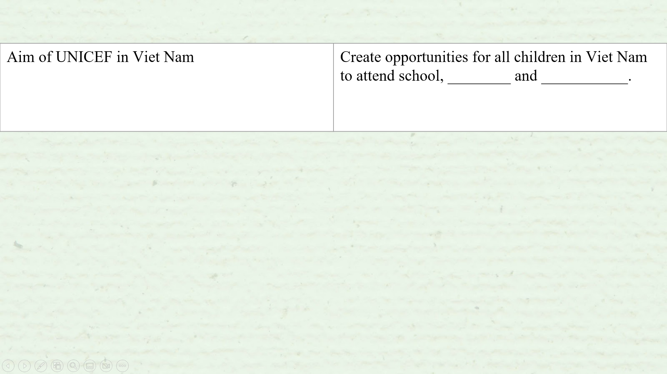
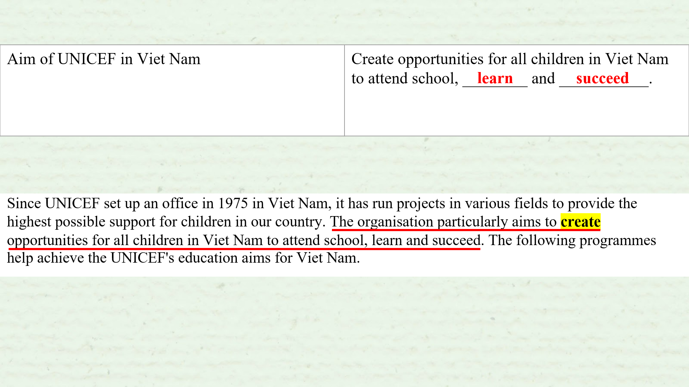
Correct tasks - Discussion
Task3
8/12
And the answer for the first box are “learn” and “succeed”. You can find these information in the first paragraph.

Slide 9
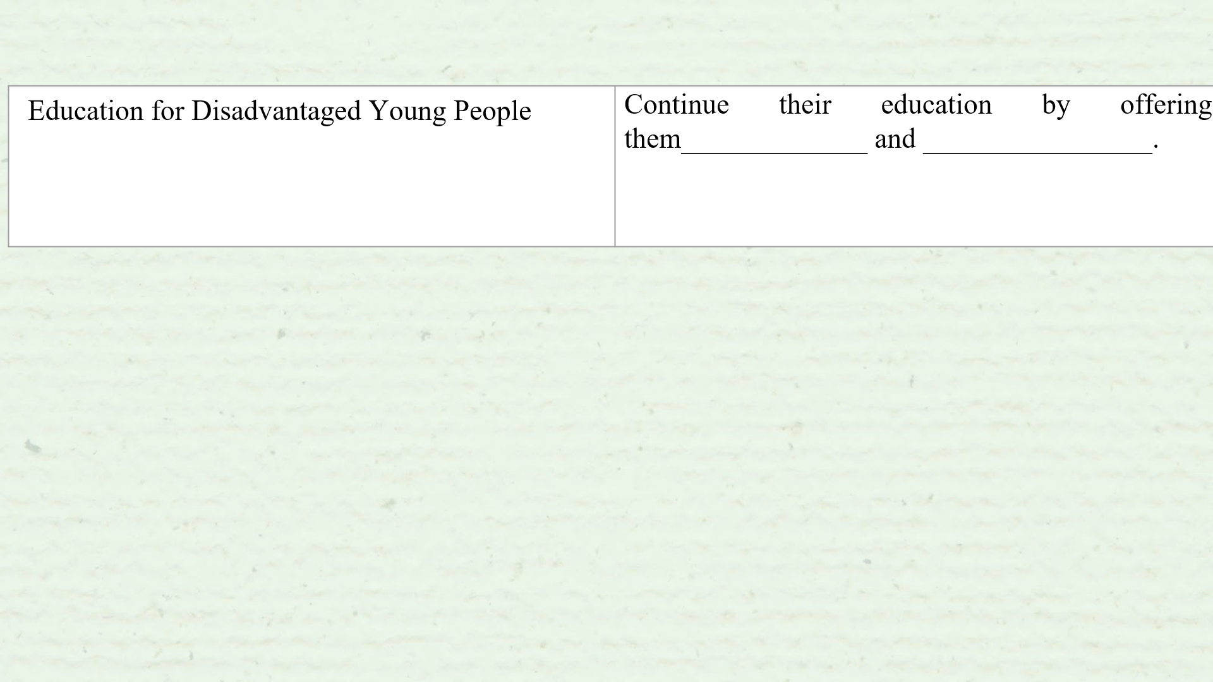
Correct tasks - Discussion
Task 3
9/12
“Job training” and “career advice” are the answer for the second box. The evidence is in the second paragraph.

Slide 10
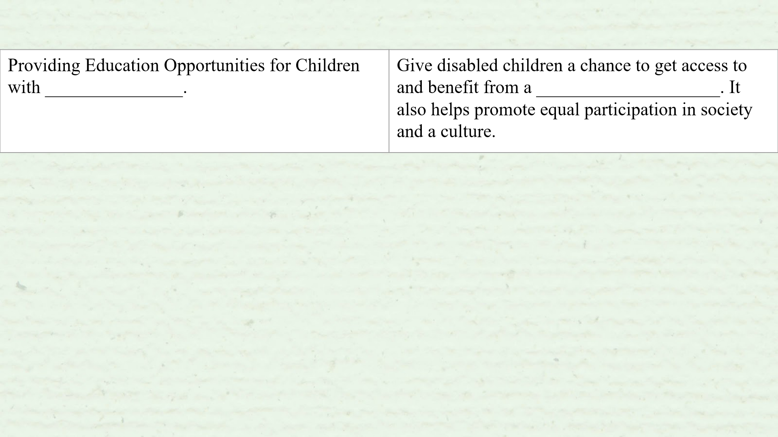
Correct tasks - Discussion
Task 3
10/12
Come to the next box, we can see “Disabilities” and “quality education” are the answers. And here are the evidences.

Slide 11
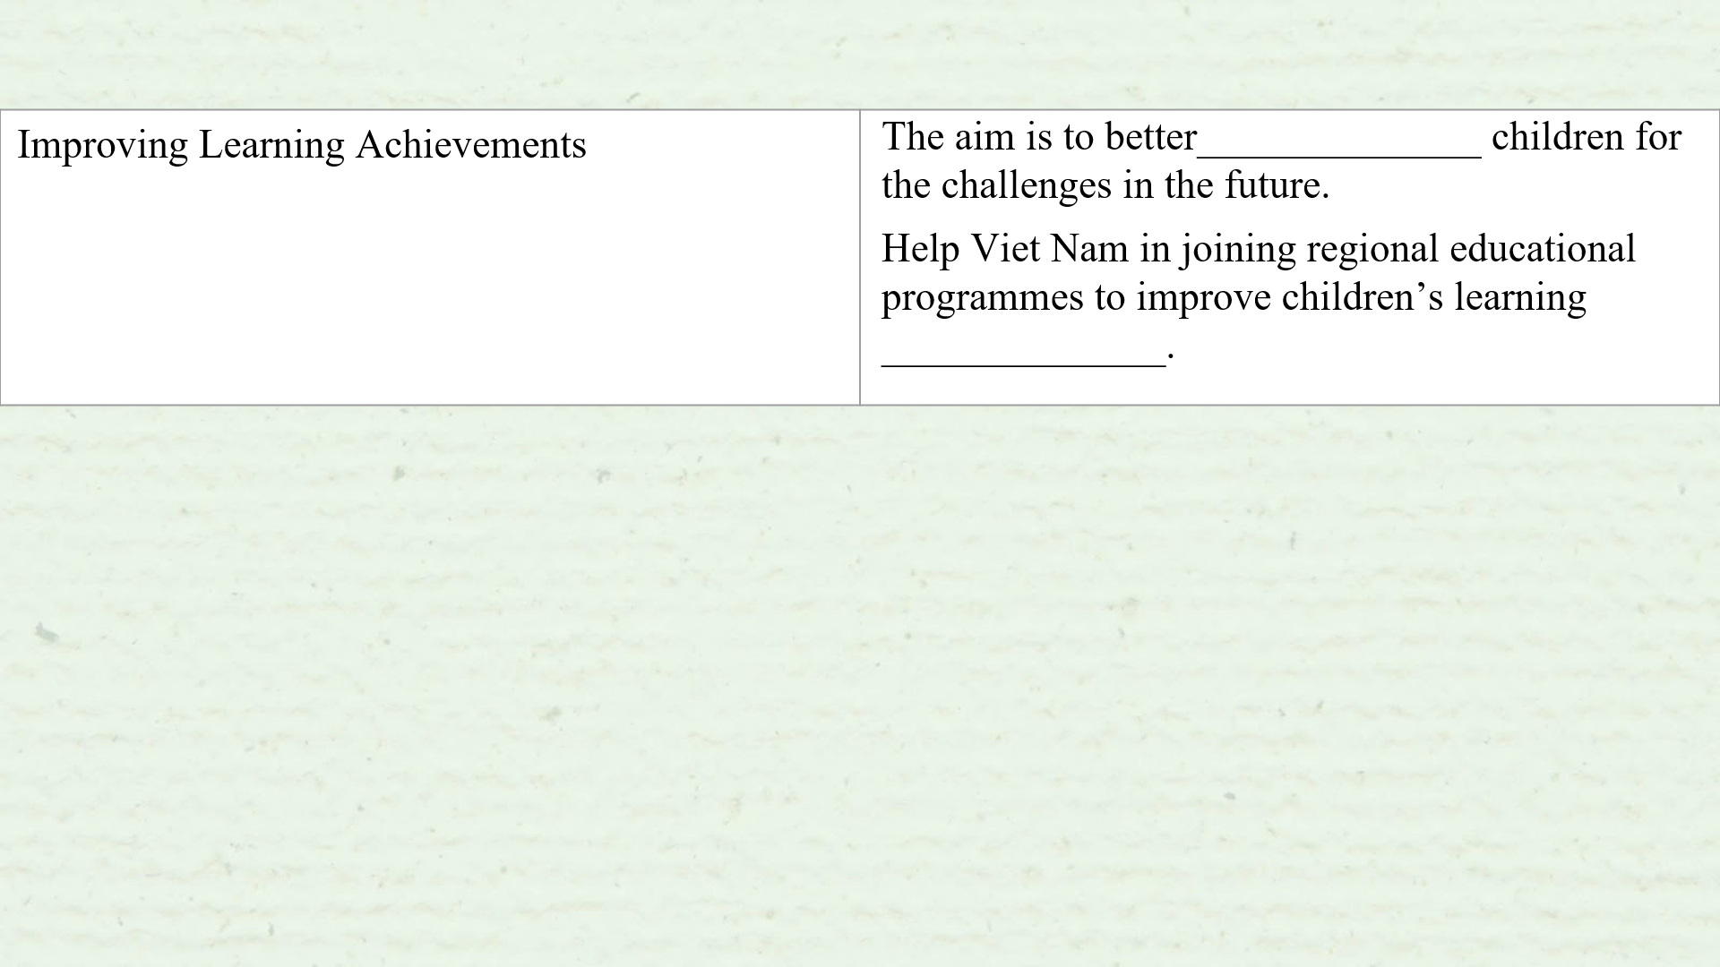
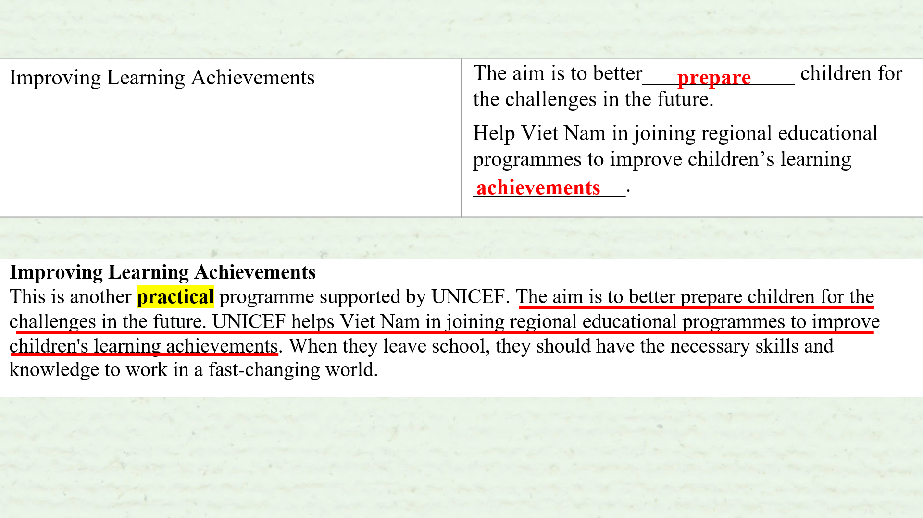
Correct tasks - Discussion
Task 3
11/12
The last box have “prepare” and “achievement” filled in the 2 blanks. And the evidence is in the last paragraph.

Slide 12
Correct tasks - Discussion
Discussion
12/12
Come to the Discussion part, Write a paragraph from 120 to 150 words to talk about which programme of UNICEF can be most useful for your local community and post in on Padlet.

