Slide 1
Unit 7: VIET NAM AND INTERNATIONAL ORGANISATIONS
SPEAKING
Speaking

Slide 2
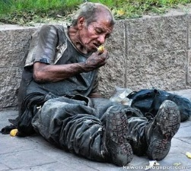
VOCABULARY
Poor (adj)
Poverty
(n)
/ˈpɒv.ə.ti/
the condition of being extremely poor
E.g. : Two million people in the city live in poverty.
Phrase: reduce the poverty

Slide 3
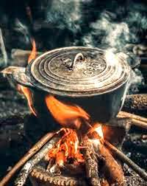
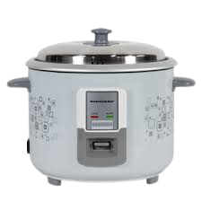
VOCABULARY
Job market (n.phr)
/ʤɒb ˈmɑːkɪt/
the number of jobs that are available in a particular place or for a particular type of work
E.g. : Women and the elderly often do not fare well in the same job market..

Slide 4
VOCABULARY
Focus on (v.phr)
/ˈfəʊkəs ɒn/
to give a lot of attention to one particular person, subject, or thing
Focus on + V-ing
E.g. : It focuses on helping disadvantaged teenagers continue their education.

Slide 5
MATCHING
What is the name of the programme?
A. It offers young people job training and career advice. It also teaches them essential skills for the job market.
1
What does this programme focus on?
B. It is Education for Disadvantaged Young People.
2
What are the activities of this programme?
C. It focuses on helping disadvantaged teenagers continue their education.
3

Slide 6
3
1
2
MATCHING
What is the name of the programme?
B. It is Education for Disadvantaged Young People.
Programme
What does this programme focus on?
C. It focuses on helping disadvantaged teenagers continue their education.
Name
Aim
What are the activities of this programme?
Activities
A. It offers young people job training and career advice. It also teaches them essential skills for the job market.

Slide 7
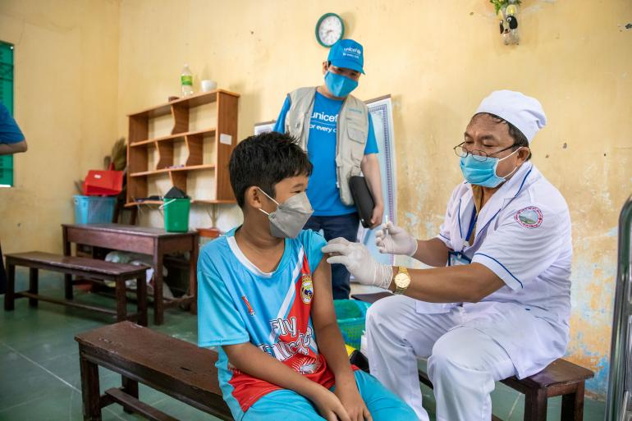
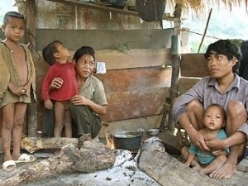
UNICEF Programme | UNDP Project
Vaccines for Children | Poverty Reduction
protecting children with life-saving vaccines | reducing poverty and developing economy in disadvantaged areas
- educating people about the benefits of vaccines - vaccinating as many children as possible | - providing technical support - helping develop solutions to local issues

Slide 8
SAMPLE
A: Now, let’s decide which programme or project will bring more benefits to people in our village. What do you think?
B: Well, I think Education for Disadvantaged Young People is more necessary for our village. You see, many teenagers here drop out of school and start working to earn a living. They really need help.
A: You’re right
B: How about you?
A: Well, I believe that Vaccines for Children will be a very useful programme for our village. You see, each family in our area has at least 2 children and not all parents are educated about the benefits of vaccines. They really need help.
B: You’re right, A.

Slide 9
?
Decide which programme or project will bring more benefits for your local area? Then post your video on LMS Discussion?
UNICEF Programme | UNDP Project
Vaccines for Children | Poverty Reduction
protecting children with life-saving vaccines | reducing poverty and developing economy in disadvantaged areas
- educating people about the benefits of vaccines - vaccinating as many children as possible | - providing technical support - helping develop solutions to local issues
I think/ believe that the project/ programme … is more important/ necessary for my local area because …
?
In our groups, most of us agree that … But one member thinks that …
This project/ programme helps local people … / brings local people more opportunities to …
?
?

